Slide 1
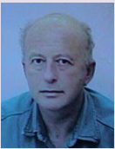
On-the-fly AES256 Decryption/Encryption for Trusted Cloud SQL DBS Position Statement
Sushil Jajodia¹, W. Litwin² & Th. Schwarz³
¹George Mason University, Fairfax, VA {jajodia@gmu.edu} ²Université Paris Dauphine, Lamsade {witold.litwin@dauphine.fr} ³Thomas Schwarz, Marquette University

Slide 2
Problem
Cloud databases often need client-side encryption.
Encryption impairs queries
Especially with numerical SQL value expressions
Select ProdName, Price as priceHT + priceHT*VAT%/100) from…where Price > 1000
Fully homomorphic encryption scheme would suffice
But response times remain impractical for DBs by far
Somewhat homomorphic encryption suffices for specific expressions only
Additively homomorphic Paillier scheme appears the most practical.
But supports evidently basically only + - over encrypted data
This stalemate lasts for 35 years
Client-side encrypted cloud SQL DBs remain a dream

Slide 3
Our Proposal : Trusted AES256 SQL Cloud DBS
Cloud DB is AES256 client-side encrypted
Cloud storage is not trusted secure
Client may send sensitive data with a query
Especially encryption key(s)
Cloud DBS decrypts on-the-fly the data needed for the query
Does it in run-time variables only
All erased at the end of the query processing
Trusted secure
Unlike cloud storage
Through software and generic RAM properties only
Without any custom trusted processing module (TPM)
Result : Cloud DBS can process any SQL query over the ciphertext entirely at the cloud
As it would do, if the DB data were plaintext only
The only price is some storege and processing overhead
Remaining practical anyhow

Slide 4
What Follows
Reference Architecture of Trusted Cloud DBS
AES DBS
Deterministic Encryption
Probabilistic Encryption
Query Processing
Performance Analysis
Storage Overhead
Processing Overhead
Conclusion

Slide 5
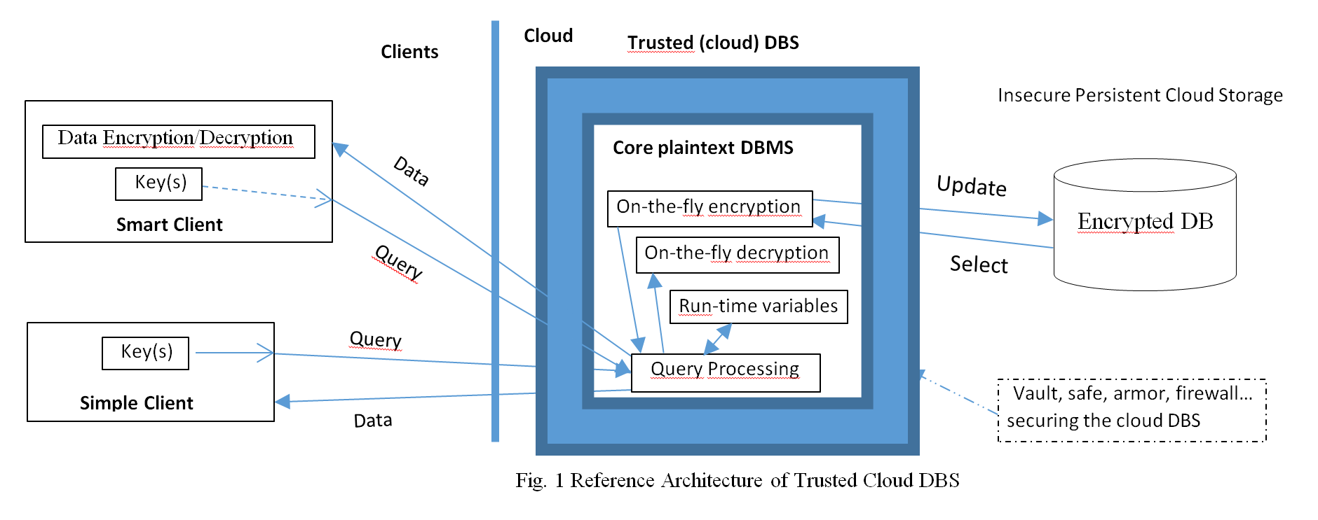
Reference Architecture

Slide 6
Why : In Trusted (cloud) DBS we trust ?
Volatile variables are more trusted in practice
Recall your bank requests to change your PWD regularly
Cloud DBS software is usually a trusted third-party product
MS, Oracle, SAS, Google…
We already have no choice, but to trust some of these guys
Billions trust Google Chrome or Edge for security of PWDs and UIDs
Cloud Software runs usually in a commercial VM
App security is their nightmare for decades

Slide 7
Why : In Trusted DBS we trust ?
The most popular processors, i.e., Intel I5 and I7 have now enclaves
Protected RAM areas
Including from Superuser
Moving target defenses may further help
Nothing new for CSIS
Can we formally quantify our trust ?
Like we do for encryption schemes ?
Nope to our best knowledge
At least at present
Trust is subjective

Slide 8
Why : Trusted DBS we trust ?
Can we expect a Trusted DB secure once et forever ?
Not at present
Rather there will be exploits, patches to exploits etc
Can folks accommodate anyway ?
Definitively Yes
No other choice at present
As we already said
Somehow imperfect security should suffice for most DBs
IRS sends all checks by paper mail
Not by armored tracks
Nor even by registered letters
Banks were robbed, are robbed, will be robbed
So what : almost every one uses them

Slide 9
Why not TPM ?
Like did MS Cipherbase most recently
See that paper for other references
We do not believe into TPMs on millions of cloud nodes
Anytime soon
Loading client key to TPM has to be trusted secure as well
Whatever the provider might invoke

Slide 10
Why AES for Trusted DBS ?
Industry-wide standard
Major cloud DBS players already use it
For cloud-side DB encryption
SQL Server 2016, MySQL, Google Cloud version of MySQL…
Many secondary storage providers have optional AES drivers
Proof of good overhead performance of the algorithm
Below AES = AES256

Slide 11
Sample Queries
Plaintext Query
Select C.Name, A.Transactions from Customer C, Account A where C.Id = ‘123’ and C.Id = A.Id ; ‘ABCD’
Only possibility for a simple client
Output comes back in plaintext
C.Id and A.Id are processed decrypted at the cloud
On-the-fly

Slide 12
Sample Queries
Ciphertext Query
Select Into Client.CacheDB.CipherTbl AESE (C.Name), AESE (A.Transactions) from Customer C, Account A where AESE (C.Id) = AESE (‘123’) and AESE (C.Id) = AESE (A.Id);
Followed by local client query
Select AESD (C.Name), AESD (A.Transactions) From CipherTbl ;
Only for smart clients
Result comes encrypted

Slide 13
Key granularity
In sample queries : 1 per table or DB
All columns of a table or DB use then same key
It could be 1 per column
Possibly different then among columns
E.g. for protection against other clients of the DB
The column key if any is given as an argument of AESE and AESD functions

Slide 14
Deterministic Encryption for AES DBS
Same ciphertext for the same plaintext
Plaintext unit is each column value
May support joins and restrictions on ciphertext
But vulnerable to frequency analysis
Even skilled user may overlook this danger
May minimize storage overhead
Even to 0%

Slide 15
Deterministic Encryption for AES DBS
1 or more numerical values per 128b AES256 bloc
Perhaps padded with zeros at left side
Before the encryption
Strings fill as many AES blocs as needed
E.g. 1 bloc per 16 8b Utf-8 characters
Last bloc may get padded, e.g., by spaces
Again before the encryption
000000000000
01123581321
101112131415
01123581321
_ _ __ _ _ S i
m p l e _ t h i
n g s _ a r e _
c o m p l e x .

Slide 16
Probabilistic Encryption for AES DBS
Pseudo-random ciphertext for occurrences of same plaintext
Not vulnerable to frequency analysis
But requires on-the-fly decryption/encryption
Client key(s) must come with the query

Slide 17
Probabilistic Encryption for AES DBS
1 numerical value per 128b AES bloc
Padded with 64b random value at left side
2⁶⁴ choices for each plaintext
Before the encryption
Strings fill half of each bloc used
With random padding of the other half
Again, before the encryption
At present, PE requires UDFs
351843875036
01123581321
489016433859
01123581321

Slide 18
Query Execution
AES DBS basically generates the execution plan as for the plaintext DB
Then adds on-the-fly decryption/encryption procedures whenever needed
Room for several choices may exist
Their best choice is future work
Easy to spot Holy Grail
Any queries to plaintext DBs become valid for ciphertext DBs of AES DBS

Slide 19
Performance AES Processing Overhead
Truecrypt benchmarks show encryption/decription rate of 1900MBs on Intel I5
Most popular processor
With AES NI instruction set, I5 661 specifically provides even 4133 MBs rate
With writing back to RAM the rates drops to 783 MBs
For plaintext 880 MBs rate
Largely enough for negligible (13% at most) AES processing overhead for AES DBS.

Slide 20
Performance Storage Overhead
Deterministic Encryption
May have no storage overhead
Padding may create some
Details are DB specific

Slide 21
Performance Storage Overhead
Probabilistic Encryption
At least 100% overhead over a column
May be more for individual small numerals
32b or 16b wide
So we possibly should group column values
As we spoke about
For the DB mixing both encryptions the overall overhead is DB specific

Slide 22
Performance Query Processing
Decryption of 100K ciphertext for SUM could need as little as 0.2ms
A benchmark for additively (only) homomorphic Paillier showed 1153ms versus 14ms of plaintext time
Our decryption overhead would be thus 1.5%
AES DBS would end up summing to 82 times faster
Paillier result needs still 50ms decryption time at the client
AES DBS ends up 85 times faster finally

Slide 23
Conclusion
Despite 35-year quest, a practical fully homomorphic encryption remains the Holy Grail
Hence remains a practical client-side encrypted cloud DB
Trusted AES cloud DBS could change the stalemate
Worth further work

Slide 24
FURTHER WORK
One should implement our proposal first on an existing major cloud DBS
This must have AES encryption/decryption scalar functions or UDFs to make those
1st choice : MySQL
Runner up : SQL Server 2016

Slide 25
Thank You for Your Attention
Witold LITWIN & al

