Slide 1

Cloud Databases
Part 2
Witold Litwin
Witold.Litwin@dauphine.fr

Slide 2
Relational Queries over SDDSs
We talk about applying SDDS files to a relational database implementation
In other words, we talk about a relational database using SDDS files instead of more traditional ones
We examine the processing of typical SQL queries
  Using the operations over SDDS files
    Key-based & scans

Slide 3
Relational Queries over SDDSs
For most, LH* based implementation appears easily feasible
The analysis applies to some extent to other potential applications
  e.g., Data Mining

Slide 4
Relational Queries over SDDSs
All the theory of parallel database processing applies to our analysis
  E.g., classical work by DeWitt team (U. Madison)
With a distinctive advantage
  The size of tables matters less
    The partitioned tables were basically static
    See specs of SQL Server, DB2, Oracle…
    Now they are scalable
  Especially this concerns the size of the output table
    Often hard to predict

Slide 5
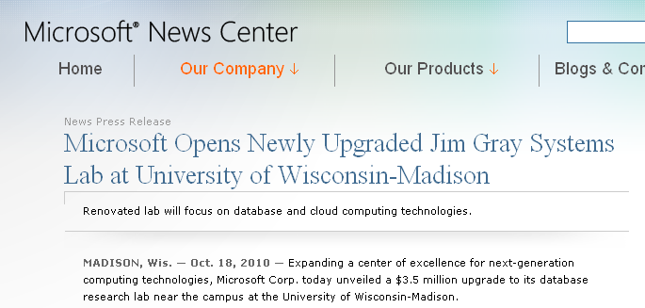
How Useful Is This Material ?
Les Apps, Démos…
http://research.microsoft.com/en-us/projects/clientcloud/default.aspx

Slide 6
How Useful Is This Material ?
The Computational Science and Mathematics division of the Pacific Northwest National Laboratory is looking for a senior researcher in Scientific Data Management to develop and pursue new opportunities. Our research is aimed at creating new, state-of-the-art computational capabilities using extreme-scale simulation and peta-scale data analytics that enable scientific breakthroughs. We are looking for someone with a demonstrated ability to provide scientific leadership in this challenging discipline and to work closely with the existing staff, including the SDM technical group manager.

Slide 7
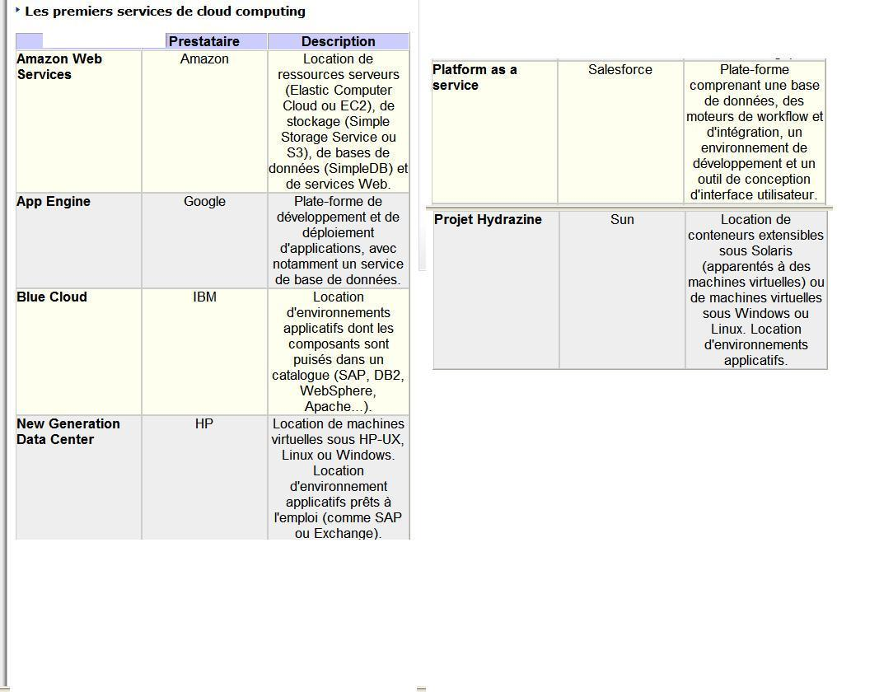
How Useful Is This Material ?

Slide 8

How Useful Is This Material ?

Slide 9
Relational Queries over SDDSs
We illustrate the point using the well-known Supplier Part (S-P) database
S (S#, Sname, Status, City)
P (P#, Pname, Color, Weight, City)
SP (S#, P#, Qty)
See my database classes on SQL
  At the Website

Slide 10
Relational Database Queries over LH* tables
Single Primary key based search
  Select * From S Where S# = S1
Translates to simple key-based LH* search
  Assuming naturally that S# becomes the primary key of the LH* file with tuples of S
    (S1 : Smith, 100, London)
    (S2 : ….

Slide 11
Relational Database Queries over LH* tables
Select * From S Where S# = S1 OR S# = S1
  A series of primary key based searches
Non key-based restriction
  …Where City = Paris or City = London
  Deterministic scan with local restrictions
    Results are perhaps inserted into a temporary LH* file

Slide 12
Relational Operations over LH* tables
Key based Insert
INSERT INTO P VALUES ('P8', 'nut', 'pink', 15, 'Nice') ;
  Process as usual for LH*
  Or use SD-SQL Server
    If no access “under the cover” of the DBMS
Key based Update, Delete
  Idem

Slide 13
Relational Operations over LH* tables
Non-key projection
  Select S.Sname, S.City from S
  Deterministic scan with local projections
    Results are perhaps inserted into a temporary LH* file (primary key ?)
Non-key projection and restriction
  Select S.Sname, S.City from S
  Where City = ‘Paris’ or City = ‘London’
  Idem

Slide 14
Relational Operations over LH* tables
Non Key Distinct
  Select Distinct City from P
  Scan with local or upward propagated aggregation towards bucket 0
      Process Distinct locally if you do not have any son
      Otherwise wait for input from all your sons
      Process Distinct together
      Send result to father if any or to client or to output table
  Alternative algorithm ?

Slide 15
Relational Operations over LH* tables
Non Key Count or Sum
  Select Count(S#), Sum(Qty) from SP
  Scan with local or upward propagated aggregation
  Eventual post-processing on the client
Non Key Avg, Var, StDev…
  Your proposal here

Slide 16
Relational Operations over LH* tables
Non-key Group By, Histograms…
  Select Sum(Qty) from SP Group By S#
  Scan with local Group By at each server
  Upward propagation
  Or post-processing at the client
  Or the result directly in the output table
    Of a priori unknown size
    That with SDDS technology does not need to be estimated upfront

Slide 17
Relational Operations over LH* tables
Equijoin
  Select * From S, SP where S.S# = SP.S#
  Scan at S and scan at SP sends all tuples to temp LH* table T1 with S# as the key
  Scan at T merges all couples (r1, r2) of records with the same S#, where r1 comes from S and r2 comes from SP
  Result goes to client or temp table T2
All above is an SD generalization of Grace hash join

Slide 18
Relational Operations over LH* tables
Equijoin & Projections & Restrictions & Group By & Aggregate &…
  Combine what above
  Into a nice SD-execution plan
Your Thesis here

Slide 19
Relational Operations over LH* tables
Equijoin & Θ -join
  Select * From S as S1, S where S.City = S1.City and S.S# < S1.S#
  Processing of equijoin into T1
  Scan for parallel restriction over T1 with the final result into client or (rather) T2
Order By and Top K
  Use RP* as output table

Slide 20
Relational Operations over LH* tables
Having
  Select Sum(Qty) from SP
  Group By S#
  Having Sum(Qty) > 100
Here we have to process the result of the aggregation
One approach: post-processing on client or temp table with results of Group By

Slide 21
Relational Operations over LH* tables
Subqueries
  In Where or Select or From Clauses
  With Exists or Not Exists or Aggregates…
  Non-correlated or correlated
Non-correlated subquery
    Select S# from S where status = (Select Max(X.status) from S as X)
  Scan for subquery, then scan for superquery

Slide 22
Relational Operations over LH* tables
Correlated Subqueries
  Select S# from S where not exists
  (Select * from SP where S.S# = SP.S#)
Your Proposal here

Slide 23
Relational Operations over LH* tables
Like (…)
  Scan with a pattern matching or regular expression
  Result delivered to the client or output table
    Your Thesis here

Slide 24
Relational Operations over LH* tables
Cartesian Product & Projection & Restriction…
Select Status, Qty From S, SP
Where City = “Paris”
  Scan for local restrictions and projection with result for S into T1 and for SP into T2
  Scan T1 delivering every tuple towards every bucket of T3
    Details not that simple since some flow control is necessary
  Deliver the result of the tuple merge over every couple to T4

Slide 25
Relational Operations over LH* tables
New or Non-standard Aggregate Functions
  Covariance
  Correlation
  Moving Average
  Cube
  Rollup
  Θ -Cube
  Skyline
  … (see my class on advanced SQL)
Your Thesis here

Slide 26
Relational Operations over LH* tables
Indexes
Create Index SX on S (sname);
Create, e.g., LH* file with records
  (Sname, (S#₁, S#₂,..)
  Where each S#_{i} is the key of a tuple with Sname
Notice that an SDDS index is not affected by location changes due to splits
  A potentially huge advantage

Slide 27
Relational Operations over LH* tables
For an ordered index use
  an RP* scheme
  or Baton
  …
For a k-d index use
  k-RP*
  or SD-Rtree
  …

Slide 28

Notes:
Van Gogh. Le ciel étoilé

Slide 29
High-availability SDDS schemes
Data remain available despite :
  any single server failure & most of two server failures
  or any up to k-server failure
    k - availability
  and some catastrophic failures
k scales with the file size
  To offset the reliability decline which would otherwise occur

Slide 30
High-availability SDDS schemes
Three principles for high-availability SDDS schemes are currently known
  mirroring (LH*m)
  striping (LH*s)
  grouping (LH*g, LH*sa, LH*rs)
Realize different performance trade-offs

Slide 31
High-availability SDDS schemes
Mirroring
  Lets for instant switch to the backup copy
  Costs most in storage overhead
    k * 100 %
  Hardly applicable for more than 2 copies per site.

Slide 32
High-availability SDDS schemes
Striping
  Storage overhead of O (k / m)
  m times higher messaging cost of a record search
  m - number of stripes for a record
  k – number of parity stripes
  At least m + k times higher record search costs while a segment is unavailable
    Or bucket being recovered

Slide 33
High-availability SDDS schemes
Grouping
  Storage overhead of O (k / m)
  m = number of data records in a record (bucket) group
  k – number of parity records per group
  No messaging overhead of a record search
  At least m + k times higher record search costs while a segment is unavailable

Slide 34
High-availability SDDS schemes
Grouping appears most practical
  Good question
    How to do it in practice ?
  One reply : LH*_{RS}
  A general industrial concept: RAIN
    Redundant Array of Independent Nodes
http://continuousdataprotection.blogspot.com/2006/04/larchitecture-rain-adopte-pour-la.html

Slide 35
LH*RS : Record Groups
LH*RS records
  LH* data records & parity records
Records with same rank r in the bucket group form a record group
Each record group gets n parity records
  Computed using Reed-Salomon erasure correction codes
    Additions and multiplications in Galois Fields
    See the Sigmod 2000 paper on the Web site for details
r is the common key of these records
Each group supports unavailability of up to n of its members

Slide 36
LH*_{RS} Record Groups
Data records
Parity records

Slide 37
LH*RS Scalable availability
Create 1 parity bucket per group until M = 2^{i1} buckets
Then, at each split,
  add 2nd parity bucket to each existing group
  create 2 parity buckets for new groups until 2^{i2} buckets
etc.

Slide 38
LH*RS Scalable availability

Slide 39
LH*RS Scalable availability

Slide 40
LH*RS Scalable availability

Slide 41
LH*RS Scalable availability

Slide 42
LH*RS Scalable availability

Slide 43
LH*RS : Galois Fields
A finite set with algebraic structure
  We only deal with GF (N) where N = 2^f ; f = 4, 8, 16
    Elements (symbols) are 4-bits, bytes and 2-byte words
Contains elements 0 and 1
Addition with usual properties
  In general implemented as XOR
      a + b = a XOR b
Multiplication and division
  Usually implemented as log_{α} / antilog calculus
    With respect to some primitive element α
    Using log / antilog tables
    a * b = antilog _{α} (log _{α} a + log _{α} b) mod (N – 1)

Slide 44
Example: GF(4)
Addition : XOR
Multiplication :
direct table
Primitive element based log / antilog tables
α⁰ = 10 α¹ = 01 ; α² = 11 ; α³ = 10
α = 01
10 = 1
00 = 0
Log tables are more efficient for a large GF

Slide 45
Example: GF(16)
Elements & logs
String
int
hex
log
Addition : XOR
0000
0
0
-∞
0001
1
1
0
α = 2
0010
2
2
1
0011
3
3
4
0100
4
4
2
Direct table would
have 256 elements
0101
5
5
8
0110
6
6
5
0111
7
7
10
1000
8
8
3
1001
9
9
14
1010
10
A
9
1011
11
B
7
1100
12
C
6
1101
13
D
13
1110
14
E
11
1111
15
F
12

Slide 46
LH*RS Parity Management
Create the m x n generator matrix G
  using elementary transformation of extended Vandermond matrix of GF elements
  m is the records group size
  n = 2^{l} is max segment size (data and parity records)
  G = [I | P]
  I denotes the identity matrix
The m symbols with the same offset in the records of a group become the (horizontal) information vector U
The matrix multiplication UG provides the (n - m) parity symbols, i.e., the codeword vector C

Slide 47
LH*RS Parity Management
Vandermond matrix V of GF elements
  For info see http://en.wikipedia.org/wiki/Vandermonde_matrix
Generator matrix G
  See http://en.wikipedia.org/wiki/Generator_matrix

Slide 48
LH*RS Parity Management
There are very many ways different G’s one can derive from any given V
  Leading to different linear codes
Central property of any V :
  Preserved by any G
Every square sub-matrix H is invertible

Slide 49
LH*RS Parity Encoding
  What means that
    for any G,
    any H being a sub-matrix of G,
    any inf. vector U
    and any codeword D ⊆ C such that
    D = U * H,
  We have :
  D * H⁻¹ = U * H * H⁻¹ = U * I = U

Slide 50
LH*RS Parity Management
  If thus :
    For at least k parity columns in P,
    For any U and C any vector V of at most k data values in U
  We get V erased
  Then, we can recover V as follows

Slide 51
LH*RS Parity Management
  We calculate C using P during the encoding phase
    We do not need full G for that since we have I at the left.
  We do it any time data are inserted
    Or updated / deleted

Slide 52
LH*RS Parity Management
During recovery phase we then :
    Choose H
    Invert it to H⁻¹
    Form D
      From remaining at least m – k data values (symbols)
        We find them in the data buckets
      From at most k values in C
        We find these in the parity buckets
    Calculate U as above
    Restore V erased values from U

Slide 53
LH*RS : GF(16) Parity Encoding
Records :
“En arche ...”, “Dans le ...”, “Am Anfang ...”, “In the beginning…”
45 6E 20 41 72 …, 41 6D 20 41 6E … 44 61 6E 73 20 …”, 49 6E 20 70 74…

Slide 54
LH*RS GF(16) Parity Encoding
Records :
“En arche ...”, “Dans le ...”, “Am Anfang ...”, “In the beginning…”
45 6E 20 41 72 …, 41 6D 20 41 6E … 44 61 6E 73 20 …”, 49 6E 20 70 74…
4 4 4 4 4 4 4 4 4 4 4 4 4 4 4 4 0

Slide 55
LH*RS GF(16) Parity Encoding
Records :
“En arche ...”, “Dans le ...”, “Am Anfang ...”, “In the beginning…”
45 6E 20 41 72 …, 41 6D 20 41 6E … 44 61 6E 73 20 …”, 49 6E 20 70 74…
4 4 4 4 4 4 4 4 4 4 4 4 4 4 4 4 0
5 1 4 9 F 8 A 4 B 1 1 2 7 E 9 9 A
5 1 4 9 F 8 A 4 B 1 1 2 7 E 9 9 A

Slide 56
LH*RS GF(16) Parity Encoding
Records :
“En arche ...”, “Dans le ...”, “Am Anfang ...”, “In the beginning…”
45 6E 20 41 72 …, 41 6D 20 41 6E … 44 61 6E 73 20 …”, 49 6E 20 70 74…
4 4 4 4 4 4 4 4 4 4 4 4 4 4 4 4 0
5 1 4 9 F 8 A 4 B 1 1 2 7 E 9 9 A
... … ... ... ... ... ... ... … ... ... ... ... … ...
6
3
6
E
E
4
6
E
D
C
E
E
6
6
4
9
D
D

Slide 57
LH*RS Record/Bucket Recovery
Performed when at most k = n - m buckets are unavailable in a segment :
Choose m available buckets of the segment
Form sub-matrix H of G from the corresponding columns
Invert this matrix into matrix H⁻¹
Multiply the horizontal vector D of available symbols with the same offset by H⁻¹
The result U contains the recovered data, i.e, the erased values forming V.

Slide 58
Example
Data buckets
“En arche ...”, “Dans le ...”, “Am Anfang ...”, “In the beginning…”
45 6E 20 41 72 …, 41 6D 20 41 6E … 44 61 6E 73 20 …”, 49 6E 20 70 74…

Slide 59
Example
Available buckets
“In the beginning…”
49 6E 20 70 74…4F 63 6E E4 … 48 6E DC EE … 4A 66 49 DD …

Slide 60
Example
Available buckets
“In the beginning…”
49 6E 20 70 74…4F 63 6E E4 … 48 6E DC EE … 4A 66 49 DD …

Slide 61
Example
Available buckets
“In the beginning…”
49 6E 20 70 74…4F 63 6E E4 … 48 6E DC EE … 4A 66 49 DD …
E.g Gauss Inversion

Slide 62
Example
Available buckets
“In the beginning…”
49 6E 20 70 74…4F 63 6E E4 … 48 6E DC EE … 4A 66 49 DD …
Recovered
symbols / buckets
4 4 4
5 1 4
6 6 6
... ,, .,

Slide 63
LH*RS Parity Management
Easy exercise:
  How do we recover erased parity values ?
    Thus in C, but not in V
    Obviously, this can happen as well.
  We can also have data & parity values erased together
    What do we do then ?

Slide 64
LH*RS : Actual Parity Management
An insert of data record with rank r creates or, usually, updates parity records r
An update of data record with rank r updates parity records r
A split recreates parity records
  Data record usually change the rank after the split

Slide 65
LH*RS : Actual Parity Encoding
Performed at every insert, delete and update of a record
  One data record at the time
Each updated data bucket produces Δ-record that sent to each parity bucket
  Δ-record is the difference between the old and new value of the manipulated data record
    For insert, the old record is dummy
    For delete, the new record is dummy

Slide 66
LH*RS : Actual Parity Encoding
The i^{th} parity bucket of a group contains only the i^{th} column of G
  Not the entire G, unlike one could expect
The calculus of i^{th} parity record is only at i^{th} parity bucket
  No messages to other data or parity buckets

Slide 67
LH*RS : Actual RS code
Over GF (2**16)
  Encoding / decoding typically faster than for our earlier GF (2**8)
    Experimental analysis
      By Ph.D Rim Moussa
  Possibility of very large record groups with very high availability level k
  Still reasonable size of the Log/Antilog multiplication table
    Ours (and well-known) GF multiplication method
Calculus using the log parity matrix
  About 8 % faster than the traditional parity matrix

Slide 68
LH*RS : Actual RS code
1-st parity record calculus uses only XORing
  1st column of the parity matrix contains 1’s only
  Like, e.g., RAID systems
  Unlike our earlier code published in Sigmod-2000 paper
1-st data record parity calculus uses only XORing
  1st line of the parity matrix contains 1’s only
It is at present for our purpose the best erasure correcting code around

Slide 69
LH*RS : Actual RS code
Parity Matrix
Logarithmic Parity Matrix
0001 0001 0001 …
0001 eb9b 2284 …
0001 2284 9é74 …
0001 9e44 d7f1 …
… … … …
0000 0000 0000 …
0000 5ab5 e267 …
0000 e267 0dce …
0000 784d 2b66 …
… … … …
All things considered, we believe our code, the most suitable erasure correcting code for high-availability SDDS files at present

Slide 70
LH*RS : Actual RS code
Systematic : data values are stored as is
Linear :
  We can use Δ-records for updates
    No need to access other record group members
  Adding a parity record to a group does not require access to existing parity records
MDS (Maximal Distance Separable)
  Minimal possible overhead for all practical records and record group sizes
    Records of at least one symbol in non-key field :
      We use 2B long symbols of GF (2**16)
More on codes
  http://fr.wikipedia.org/wiki/Code_parfait

Slide 71
Performance
(Wintel P4 1.8GHz, 1Gbs Ethernet)
Data bucket load factor : 70 %
Parity overhead : k / m
m is file parameter, m = 4,8,16…
larger m increases the recovery cost
Key search time
  Individual : 0.2419 ms
  Bulk : 0.0563 ms
File creation rate
  0.33 MB/sec for k = 0,
  0.25 MB/sec for k = 1,
  0.23 MB/sec for k = 2
Record insert time (100 B)
  Individual : 0.29 ms for k = 0,
  0.33 ms for k = 1,
  0.36 ms for k = 2
  Bulk : 0.04 ms
Record recovery time
  About 1.3 ms
Bucket recovery rate (m = 4)
  5.89 MB/sec from 1-unavailability,
  7.43 MB/sec from 2-unavailability,
  8.21 MB/sec from 3-unavailability

Slide 72
Parity Overhead
Performance
About the smallest possible
  Consequence of MDS property of RS codes
Storage overhead (in additional buckets)
  Typically k / m
Insert, update, delete overhead
  Typically k messages
Record recovery cost
  Typically 1+2m messages
Bucket recovery cost
  Typically 0.7b (m+x-1)
Key search and parallel scan performance are unaffected
  LH* performance

Slide 73
Reliability
Performance
Probability P that all the data are available
Inverse of the probability of the catastrophic k’ - bucket failure ; k’ > k
Increases for
  higher reliability p of a single node
  greater k
    at expense of higher overhead
But it must decrease regardless of any fixed k when the file scales
k should scale with the file
How ??

Slide 74
Uncontrolled availability
m = 4, p = 0.15
P
OK
M
m = 4, p = 0.1
OK ++
P
M

Slide 75
RP* schemes
Produce 1-d ordered files
  for range search
Uses m-ary trees
  like a B-tree
Efficiently supports range queries
  LH* also supports range queries
    but less efficiently
Consists of the family of three schemes
  RP*_{N} RP*_{C} and RP*_{S}

Slide 76
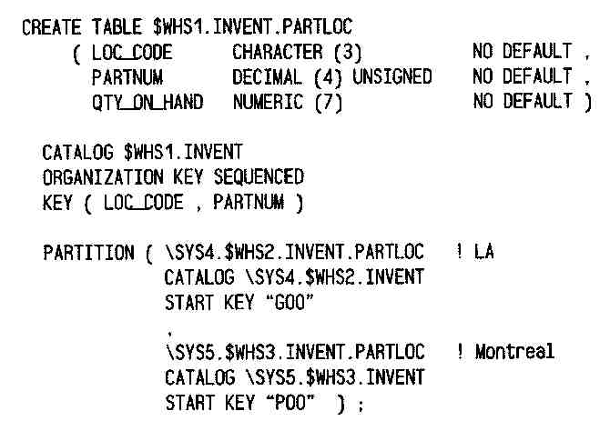
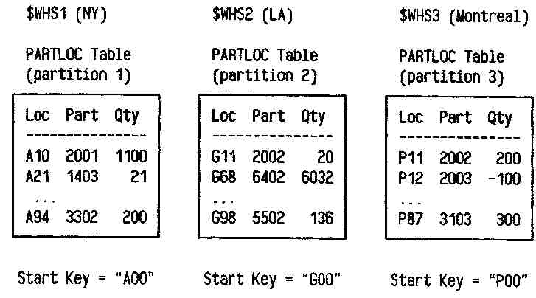
Current PDBMS technology
(Pioneer: Non-Stop SQL)
Static Range Partitioning
Done manually by DBA
Requires goods skills
Not scalable

Slide 77
RP* schemes

Slide 79
RP* Range Query
Searches for all records in query range Q
  Q = [c1, c2] or Q = ]c1,c2] etc
The client sends Q
  either by multicast to all the buckets
    RP*n especially
  or by unicast to relevant buckets in its image
    those may forward Q to children unknown to the client

Slide 80
RP* Range Query Termination
Time-out
Deterministic
  Each server addressed by Q sends back at least its current range
  The client performs the union U of all results
  It terminates when U covers Q

Slide 81
RP*c client image
IAMs
0
- ∞
for
2
in
of
1
of
∞
3
for
in

Slide 82
RP*s
Distr.
Index
root
Distr.
Index
root
Distr.
Index
page
(
Distr.
Index
page
b
c
−∞
∞
a
i
)
*
n
b
(
a
a
−∞
)
a
i
b
∞
3 in
1
n
i
2 of
−∞
c
0
f
n
∞
o
0
f
r
3
c
o
r
2
o
f
1
t
h
e
s
e
4
for
to
of
for
t
of
h
e
s
the
it
in
and
the
e
it
in
t
and
is
a
is
i
o
a
that
i
t
h
i
t
s
h
a
a
a
a
t
a
a
a
a
a
a
for
∞
for
t
∞
h
e
s
−∞
of
in
−∞
e
of
in
of
in
for
of
in
t
h
e
s
f
e
o
0
1
2
3
r
0
1
2
3
4
IAM =
traversed pages
A
n
R
P
*
f
i
l
e
w
i
t
h
(
a
)
2
-
l
e
v
e
l
k
e
r
n
e
l
,
a
n
s
d
(
b
)
3
-
l
e
v
e
l
k
e
r
n
e
l
.

Slide 83
RP*_{N}
drawback
of
multicasting

Slide 84
RP*_{N}
RP*_{C}
RP*_{S}
LH*

Slide 85
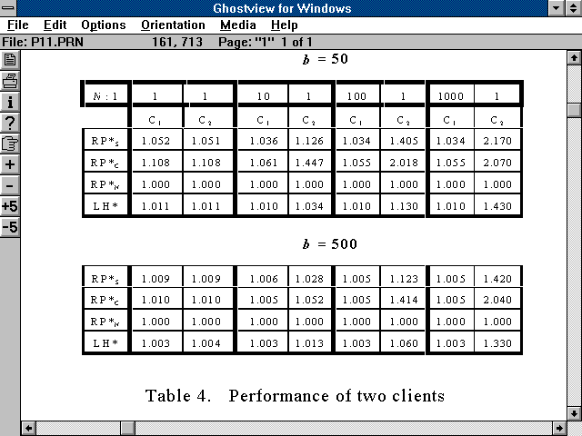

Slide 87
RP* Bucket Structure
Header
  Bucket range
  Address of the index root
  Bucket size…
Index
  Kind of of B+-tree
  Additional links
    for efficient index splitting during RP* bucket splits
Data
  Linked leaves with the data

Slide 88
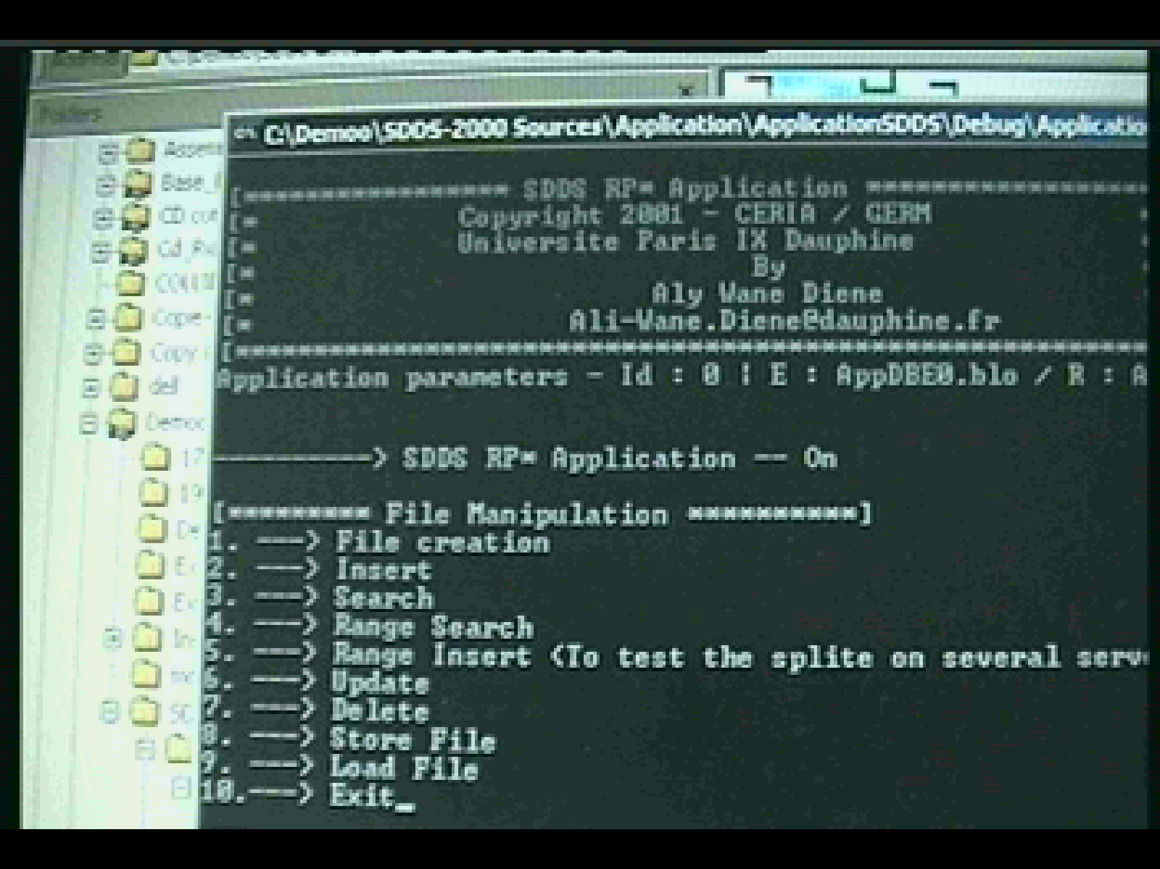
SDDS-2004 Menu Screen

Slide 89
SDDS-2000: Server Architecture
Several buckets of different SDDS files
Multithread architecture
Synchronization queues
Listen Thread for incoming requests
SendAck Thread for flow control
Work Threads for
  request processing
  response sendout
  request forwarding
UDP for shorter messages
(< 64K)
TCP/IP for longer data exchanges

Slide 90
SDDS-2000: Client Architecture
2 Modules
  Send Module
  Receive Module
Multithread Architecture
  SendRequest
  ReceiveRequest
  AnalyzeResponse1..4
  GetRequest
  ReturnResponse
Synchronization Queues
Client Images
Flow control

Slide 91
Performance Analysis
Experimental Environment
Six Pentium III 700 MHz
  Windows 2000
  128 MB of RAM
  100 Mb/s Ethernet
Messages
  180 bytes : 80 for the header, 100 for the record
  Keys are random integers within some interval
  Flow Control sliding window of 10 messages
Index
  Capacity of an internal node : 80 index elements
  Capacity of a leaf : 100 records

Slide 92
Performance Analysis
File Creation
Bucket capacity : 50.000 records
150.000 random inserts by a single client
With flow control (FC) or without
File creation time
Average insert time

Slide 93
Discussion
Creation time is almost linearly scalable
Flow control is quite expensive
  Losses without were negligible
Both schemes perform almost equally well
  RP*C slightly better
    As one could expect
Insert time 30 faster than for a disk file
Insert time appears bound by the client speed

Slide 94
Performance Analysis
File Creation
File created by 120.000 random inserts by 2 clients
Without flow control
File creation by two clients : total time and per insert
Comparative file creation time by one or two clients

Slide 95
Discussion
Performance improves
Insert times appear bound by a server speed
More clients would not improve performance of a server

Slide 96
Performance Analysis
Split Time
Split times for different bucket capacity

Slide 97
Discusion
About linear scalability in function of bucket size
Larger buckets are more efficient
Splitting is very efficient
  Reaching as little as 40 μs per record

Slide 98
Performance Analysis
Insert without splits
Up to 100000 inserts into k buckets ; k = 1…5
Either with empty client image adjusted by IAMs or with correct image
Insert performance

Slide 99
Performance Analysis
Insert without splits
100 000 inserts into up to k buckets ; k = 1...5
Client image initially empty
Total insert time
Per record time

Slide 100
Discussion
Cost of IAMs is negligible
Insert throughput 110 times faster than for a disk file
  90 μs per insert
RP*N appears surprisingly efficient for more buckets, closing on RP*c
  No explanation at present

Slide 101
Performance Analysis
Key Search
A single client sends 100.000 successful random search requests
The flow control means here that the client sends at most 10 requests without reply
Search time (ms)

Slide 102
Performance Analysis
Key Search
Total search time
Search time per record

Slide 103
Discussion
Single search time about 30 times faster than for a disk file
  350 μs per search
Search throughput more than 65 times faster than that of a disk file
  145 μs per search
RP*N appears again surprisingly efficient with respect RP*c for more buckets

Slide 104
Performance Analysis
Range Query
Deterministic termination
Parallel scan of the entire file with all the 100.000 records sent to the client
Range query total time
Range query time per record

Slide 105
Discussion
Range search appears also very efficient
  Reaching 100 μs per record delivered
More servers should further improve the efficiency
  Curves do not become flat yet

Slide 106
Scalability Analysis
The largest file at the current configuration
  64 MB buckets with b = 640 K
  448.000 records per bucket loaded at 70 % at the average.
  2.240.000 records in total
  320 MB of distributed RAM (5 servers)
  264 s creation time by a single RP*N client
  257 s creation time by a single RP*C client
  A record could reach 300 B
    The servers RAMs were recently upgraded to 256 MB

Slide 107
Scalability Analysis
If the example file with b = 50.000 had scaled to 10.000.000 records
  It would span over 286 buckets (servers)
    There are many more machines at Paris 9
  Creation time by random inserts would be
    1235 s for RP*_{N}
    1205 s for RP*_{C}
  285 splits would last 285 s in total
  Inserts alone would last
    950 s for RP*_{N}
    920 s for RP*_{C}

Slide 108
Actual results for a big file
Bucket capacity : 751K records, 196 MB
Number of inserts : 3M
Flow control (FC) is necessary to limit the input queue at each server

Slide 109
Actual results for a big file
Bucket capacity : 751K records, 196 MB
Number of inserts : 3M
GA : Global Average; MA : Moving Average

Slide 110
Related Works
Comparative Analysis

Slide 111
Discussion
The 1994 theoretical performance predictions for RP* were quite accurate
RP* schemes at SDDS-2000 appear globally more efficient than LH*
  No explanation at present

Slide 112
Conclusion
SDDS-2000 : a prototype SDDS manager for Windows multicomputer
  Various SDDSs
  Several variants of the RP*
Performance of RP* schemes appears in line with the expectations
  Access times in the range of a fraction of a millisecond
  About 30 to 100 times faster than a disk file access performance
  About ideal (linear) scalability
Results prove also the overall efficiency of SDDS-2000 architecture

Slide 113
2011 Cloud Infrastructures in RP* Footsteps
RP* were the 1st schemes for SD Range Partitioning
  Back to 1994, to recall.
SDDS 2000, up to SDDS-2007 were the 1st operational prototypes
To create RP clouds in current terminology

Slide 114
2011 Cloud Infrastructures in RP* Footsteps
Today there are several mature implementations using SD-RP
None cites RP* in the references
Practice contrary to the honest scientific practice
Unfortunately this seems to be more and more often thing of the past
Especially for the industrial folks

Slide 115
2011 Cloud Infrastructures in RP* Footsteps (Examples)
Prominent cloud infrastructures using SD-RP systems are disk oriented
GFS (2006)
  Private cloud of Key, Value type
  Behind Google’s BigTable
  Basically quite similar to RP*s & SDDS-2007
  Many more features naturally including replication

Slide 116
2011 Cloud Infrastructures in RP* Footsteps (Examples)
Windows Azure Table (2009)
  Public Cloud
  Uses (Partition Key, Range Key, value)
  Each partition key defines a partition
  Azure may move the partitions around to balance the overall load

Slide 117
2011 Cloud Infrastructures in RP* Footsteps (Examples)
Windows Azure Table (2009) cont.
  It thus provides splitting in this sense
  High availability uses the replication
  Azure Table details are yet sketchy
  Explore MS Help

Slide 118
2011 Cloud Infrastructures in RP* Footsteps (Examples)
MongoDB
  Quite similar to RP*s
  For private clouds of up to 1000 nodes at present
  Disk-oriented
  Open-Source
  Quite popular among the developers in the US
  Annual conf (last one in SF)

Slide 119
2011 Cloud Infrastructures in RP* Footsteps (Examples)
Yahoo PNuts
Private Yahoo Cloud
Provides disk-oriented SD-RP, including over hashed keys
  Like consistent hash
Architecture quite similar to GFS & SDDS 2007
But with more features naturally with respect to the latter

Slide 120
2011 Cloud Infrastructures in RP* Footsteps (Examples)
Some others
  Facebook Cassandra
    Range partitioning & (Key Value) Model
    With Map/Reduce
  Facebook Hive
    SQL interface in addition
Idem for AsterData

Slide 121
2011 Cloud Infrastructures in RP* Footsteps (Examples)
Several systems use consistent hash
  Amazon
This amounts largely to range partitioning
Except that range queries mean nothing

Slide 122

CERIA SDDS Prototypes

Slide 123
Prototypes
LH*RS Storage (VLDB 04)
SDDS –2006 (several papers)
  RP* Range Partitioning
  Disk back-up (alg. signature based, ICDE 04)
  Parallel string search (alg. signature based, ICDE 04)
  Search over encoded content
    Makes impossible any involuntary discovery of stored data actual content
    Several times faster pattern matching than for Boyer Moore
  Available at our Web site
SD –SQL Server (CIDR 07 & BNCOD 06)
  Scalable distributed tables & views
SD-AMOS and AMOS-SDDS

Slide 124
SDDS-2006 Menu Screen

Slide 125
LH*RS Prototype
Presented at VLDB 2004
Vidéo démo at CERIA site
Integrates our scalable availability RS based parity calculus with LH*
Provides actual performance measures
  Search, insert, update operations
  Recovery times
See CERIA site for papers
  SIGMOD 2000, WDAS Workshops, Res. Reps. VLDB 2004

Slide 126
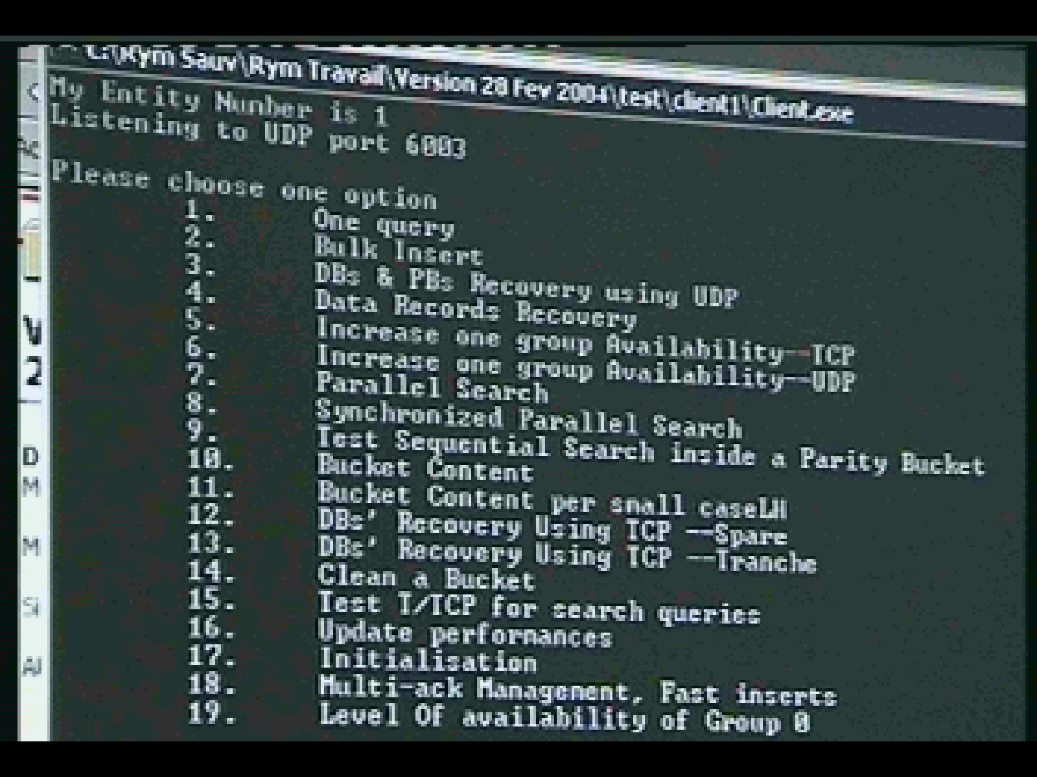
LH*RS Prototype : Menu Screen

Slide 127
SD-SQL Server : Server Node
The storage manager is a full scale SQL-Server DBMS
SD SQL Server layer at the server node provides the scalable distributed table management
  SD Range Partitioning
Uses SQL Server to perform the splits using SQL triggers and queries
  But, unlike an SDDS server, SD SQL Server does not perform query forwarding
  We do not have access to query execution plan

Slide 128
SD-SQL Server : Client Node
Manages a client view of a scalable table
  Scalable distributed partitioned view
    Distributed partitioned updatable iew of SQL Server
Triggers specific image adjustment SQL queries
  checking image correctness
    Against the actual number of segments
    Using SD SQL Server meta-tables (SQL Server tables)
  Incorrect view definition is adjusted
  Application query is executed.
The whole system generalizes the PDBMS technology
  Static partitioning only

Slide 129
SD-SQL Server
Gross Architecture

Slide 130
SD-SQL Server Architecture
Server side
DB_1
DB_2
Segment
Segment
………
Split
Split
Split
SD_C
SD_RP
SD_C
SD_RP
Meta-tables
Meta-tables
SQL Server 1
SQL Server 2
SQL …
Each segment has a check constraint on the partitioning attribute
Check constraints partition the key space
Each split adjusts the constraint

Slide 131
Single Segment Split
Single Tuple Insert
Check Constraint?
p=INT(b/2)
C( S)= ∅ ⇒{ c: c < h = c (b+1-p)}
C( S₁)={c: c > = c (b+1-p)}
b+1
b
b+1-p
p
S
S
S₁
SELECT TOP Pi * INTO Ni.Si FROM S ORDER BY C ASC
SELECT TOP Pi * WITH TIES INTO Ni.S1 FROM S ORDER BY C ASC

Slide 132
Single Segment Split
Bulk Insert
Single segment split

Slide 133
Multi-Segment Split
Bulk Insert
Multi-segment split

Slide 134
Split with SDB Expansion
sd_create_node_database
sd_create_node
sd_create_node_database
N1
N2
N3
N3
N4
Ni
NDB
DB1
NDB
DB1
NDB
DB1
NDB
DB1
NDB
DB1
NDB
DB1
SDB DB1
SDB DB1
SDB DB1
sd_insert
sd_insert
sd_insert
…….
Scalable Table T

Slide 135
SD-DBS Architecture
Client View
Distributed Partitioned Union All View
Db_1.Segment1
Db_2. Segment1
…………
Client view may happen to be outdated
  not include all the existing segments

Slide 136
Scalable (Distributed) Table
Internally, every image is a specific SQL Server view of the segments:
  Distributed partitioned union view
CREATE VIEW T AS SELECT * FROM N2.DB1.SD._N1_T
UNION ALL SELECT * FROM N3.DB1.SD._N1_T
UNION ALL SELECT * FROM N4.DB1.SD._N1_T
  Updatable
    Through the check constraints
  With or without Lazy Schema Validation

Slide 137
SD-SQL Server
Gross Architecture : Appl. Query Processing
9999 ?

Slide 138
Scalable Queries Management
USE SkyServer /* SQL Server command */
Scalable Update Queries
  sd_insert ‘INTO PhotoObj SELECT * FROM
  Ceria5.Skyserver-S.PhotoObj’
Scalable Search Queries
  sd_select ‘* FROM PhotoObj’
  sd_select ‘TOP 5000 * INTO PhotoObj1 FROM PhotoObj’, 500

Slide 139
Concurrency
SD-SQL Server processes every command as SQL distributed transaction at Repeatable Read isolation level
  Tuple level locks
  Shared locks
  Exclusive 2PL locks
  Much less blocking than the Serializable Level

Slide 140
Concurrency
Splits use exclusive locks on segments and tuples in RP meta-table.
  Shared locks on other meta-tables: Primary, NDB meta-tables
Scalable queries use basically shared locks on meta-tables and any other table involved
All the conccurent executions can be shown serializable

Slide 141
Image Adjustment
(Q) sd_select ‘COUNT (*) FROM PhotoObj’
Query (Q1) execution time

Slide 142
SD-SQL Server / SQL Server
(Q): sd_select ‘COUNT (*) FROM PhotoObj’
Execution time of (Q) on SQL Server and SD-SQL Server

Slide 143
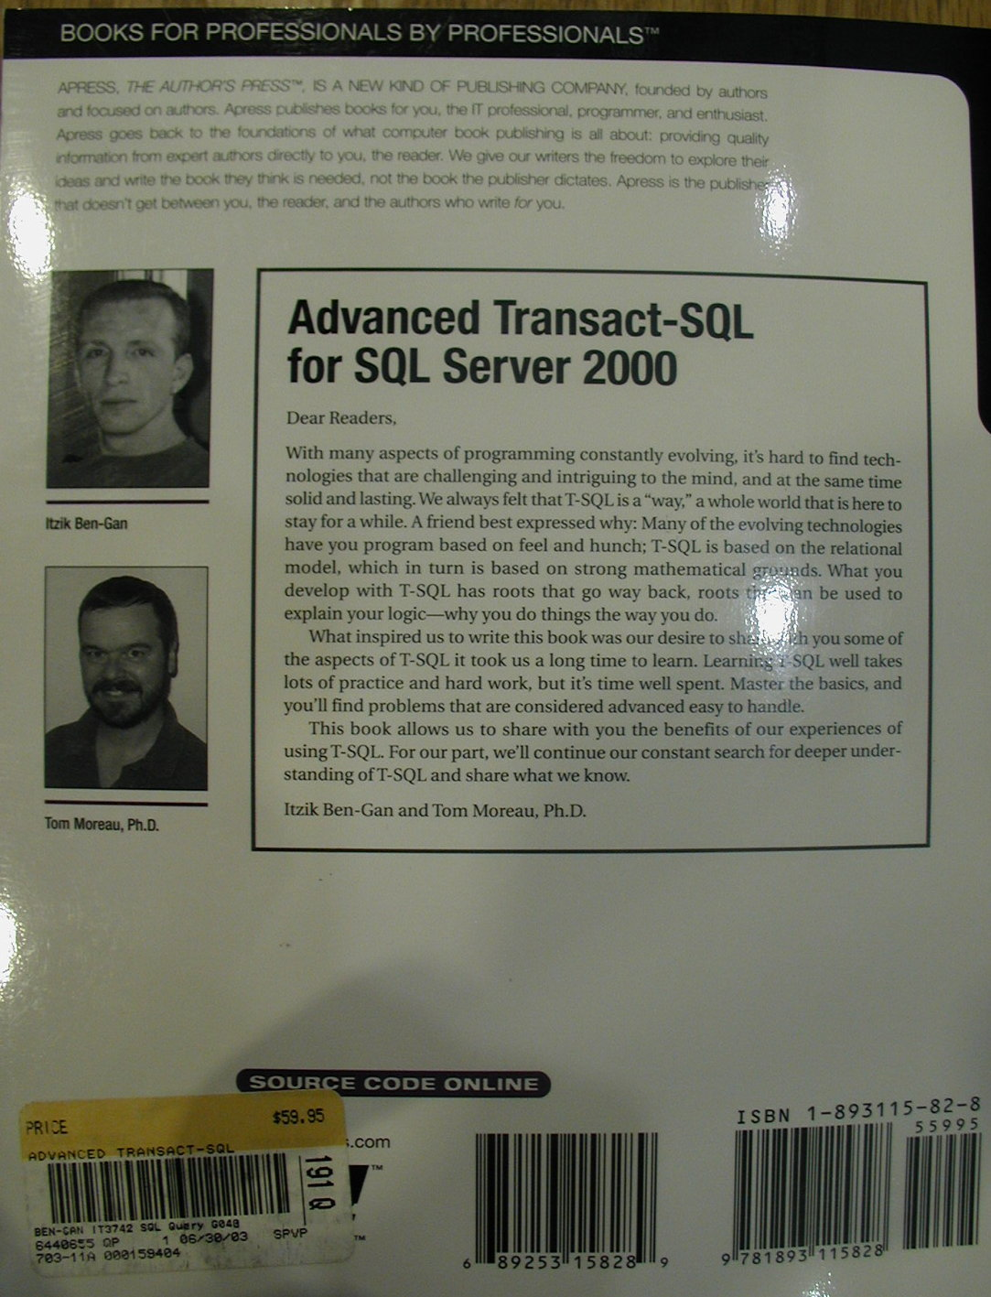
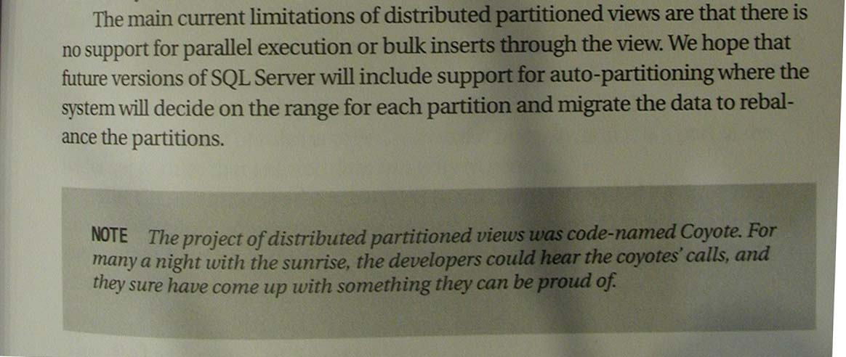
Will SD SQL Server be useful ?
Here is a non-MS hint from the practical folks who knew nothing about it
Book found in Redmond Town Square Border’s Cafe

Slide 144
Algebraic Signatures for SDDS
Small string (signature) characterizes the SDDS record.
Calculate signature of bucket from record signatures.
  Determine from signature whether record / bucket has changed.
    Bucket backup
    Record updates
    Weak, optimistic concurrency scheme
    Scans

Slide 145
Signatures
Small bit string calculated from an object.
Different Signatures  Different Objects
Different Objects  _{with high probability} Different Signatures.
    A.k.a. hash, checksum.
    Cryptographically secure: Computationally impossible to find an object with the same signature.

Slide 146
Uses of Signatures
Detect discrepancies among replicas.
Identify objects
  CRC signatures.
  SHA1, MD5, … (cryptographically secure).
  Karp Rabin Fingerprints.
  Tripwire.

Slide 147
Properties of Signatures
Cryptographically Secure Signatures:
  Cannot produce an object with given signature.
  ⇒ Cannot substitute objects without changing signature.
Algebraic Signatures:
  Small changes to the object change the signature for sure.
    Up to the signature length (in symbols)
  One can calculate new signature from the old one and change.
Both:
  Collision probability 2^{-f} (f length of signature).

Slide 148
Definition of Algebraic Signature:
Page Signature
Page P = (p₀, p₁, … p_{l-1}).
  Component signature.
  n-Symbol page signature
  α = (α, α², α³, α⁴…α^{n}) ; α_{i} = α ^{i}
    α is a primitive element, e.g., α = 2.

Slide 149
Algebraic Signature Properties
Page length < 2^{f}-1: Detects all changes of up to n symbols.
Otherwise, collision probability = 2^{-nf}
Change starting at symbol r:

Slide 150
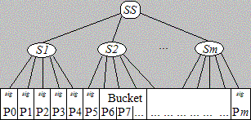
Algebraic Signature Properties
Signature Tree: Speed up comparison of signatures

Slide 151
Uses for Algebraic Signatures in SDDS
Bucket backup
Record updates
Weak, optimistic concurrency scheme
Stored data protection against involuntary disclosure
Efficient scans
  Prefix match
  Pattern match (see VLDB 07)
  Longest common substring match
  …..
Application issued checking for stored record integrity

Slide 152
Signatures for File Backup
Backup an SDDS bucket on disk.
Bucket consists of large pages.
Maintain signatures of pages on disk.
Only backup pages whose signature has changed.

Slide 153
Signatures for File Backup
BUCKET
Page 1
Page 2
Page 3
Page 4
Page 5
Page 6
Page 7
Backup Manager
sig 1
sig 2
sig 3
sig 4
sig 5
sig 6
sig 7
DISK
Page 1
Page 2
Page 3
Page 4
Page 5
Page 6
Page 7
Page 3
sig 3 ≠
Application changes page 3
Application access but does not change page 2
Backup manager will only backup page 3

Slide 154
Record Update w. Signatures
Application requests record R
Client provides record R, stores signature sig_{before}(R)
Application updates record R: hands record to client.
Client compares sig_{after}(R) with sig_{before}(R):
Only updates if different.
Prevents messaging of pseudo-updates

Slide 155
Scans with Signatures
Scan = Pattern matching in non-key field.
Send signature of pattern
  SDDS client
Apply Karp-Rabin-like calculation at all SDDS servers.
  See paper for details
Return hits to SDDS client
Filter false positives.
  At the client

Slide 156
Scans with Signatures
Client: Look for “sdfg”.
Calculate signature for sdfg.
Server: Field is “qwertyuiopasdfghjklzxcvbnm”
Compare with signature for “qwer”
Compare with signature for “wert”
Compare with signature for “erty”
Compare with signature for “rtyu”
Compare with signature for “tyui”
Compare with signature for “uiop”
Compare with signature for “iopa”
Compare with signature for “sdfg” ⇒ HIT

Slide 157
Record Update
SDDS updates only change the non-key field.
Many applications write a record with the same value.
Record Update in SDDS:
  Application requests record.
  SDDS client reads record R_{b} .
  Application request update.
  SDDS client writes record R_{a} .

Slide 158
Record Update w. Signatures
Weak, optimistic concurrency protocol:
  Read-Calculation Phase:
    Transaction reads records, calculates records, reads more records.
    Transaction stores signatures of read records.
  Verify phase: checks signatures of read records; abort if a signature has changed.
  Write phase: commit record changes.
Read-Commit Isolation ANSI SQL

Slide 159
Performance Results
1.8 GHz P4 on 100 Mb/sec Ethernet
Records of 100B and 4B keys.
Signature size 4B
  One backup collision every 135 years at 1 backup per second.

Slide 160
Performance Results:
Backups
Signature calculation 20 - 30 msec/1MB
Somewhat independent of details of signature scheme
GF(2¹⁶) slightly faster than GF(2⁸)
Biggest performance issue is caching.
Compare to SHA1 at 50 msec/MB

Slide 161
Performance Results:
Updates
Run on modified SDDS-2000
  SDDS prototype at the Dauphine
Signature Calculation
  5 μsec / KB on P4
  158 μsec/KB on P3
  Caching is bottleneck
Updates
  Normal updates 0.614 msec / 1KB records
  Normal pseudo-update 0.043 msec / 1KB record

Slide 162
More on Algebraic Signatures
Page P : a string of l < 2^{f} -1 symbols p_{i} ; i = 0..l-1
n-symbol signature base :
  a vector α = (α₁…α_{n}) of different non-zero elements of the GF.
(n-symbol) P signature based on α : the vector
Where for each α :

Slide 163
The sig_{α,n} and sig²_{α,n} schemes
sig_{α,n}
α = (α, α², α³…α^{n}) with n << ord(a) = 2^{f} - 1.
The collision probability is 2^{-nf} at best
sig²_{α,n}
  α = (α,, α², α⁴, α⁸…α^{2n})
The randomization is possibly better for more than 2-symbol signatures since all the α^{i} are primitive
In SDDS-2002 we use sig_{α,n}
  Computed in fact for p’ = antilog p
    To speed-up the multiplication

Slide 164
The sig_{α,n} Algebraic Signature
If P1 and P2
  Differ by at most n symbols,
  Have no more than 2^{f} – 1
then probability of collision is 0.
  New property at present unique to sig_{α,n}
  Due to its algebraic nature
If P1 and P2 differ by more than n symbols, then probability of collision reaches 2^{-nf}
  Good behavior for Cut/Paste
    But not best possible
See our IEEE ICDE-04 paper for other properties

Slide 165
The sig_{α,n} Algebraic Signature
Application in SDDS-2004
Disk back up
  RAM bucket divided into pages
  4KB at present
  Store command saves only pages whose signature differs from the stored one
  Restore does the inverse
Updates
  Only effective updates go from the client
    E.g. blind updates of a surveillance camera image
  Only the update whose before signature ist that of the record at the server gets accepted
    Avoidance of lost updates

Slide 166
The sig_{α,n} Algebraic Signature
Application in SDDS-2004
Non-key distributed scans
  The client sends to all the servers the signature S of the data to find using:
  Total match
    The whole non-key field F matches S
      SF = S
  Partial match
    S is equal to the signature Sf of a sub-field f of F
      We use a Karp-Rabin like computation of Sf

Slide 167
SDDS & P2P
P2P architecture as support for an SDDS
  A node is typically a client and a server
  The coordinator is super-peer
  Client & server modules are Windows active services
    Run transparently for the user
    Referred to in Start Up directory
See :
  Planetlab project literature at UC Berkeley
  J. Hellerstein tutorial VLDB 2004

Slide 168
SDDS & P2P
P2P node availability (churn)
  Much lower than traditionally for a variety of reasons
    (Kubiatowicz & al, Oceanstore project papers)
A node can leave anytime
  Letting to transfer its data at a spare
  Taking data with
LH*RS parity management seems a good basis to deal with all this

Slide 169
LH*_{RS}^{P2P}
Each node is a peer
  Client and server
Peer can be
  (Data) Server peer : hosting a data bucket
  Parity (sever) peer : hosting a parity bucket
    LH*_{RS} only
  Candidate peer: willing to host

Slide 170
LH*_{RS}^{P2P}
A candidate node wishing to become a peer
  Contacts the coordinator
  Gets an IAM message from some peer becoming its tutor
    With level j of the tutor and its number a
    All the physical addresses known to the tutor
  Adjusts its image
  Starts working as a client
  Remains available for the « call for server duty »
    By multicast or unicast

Slide 171
LH*_{RS}^{P2P}
Coordinator chooses the tutor by LH over the candidate address
  Good load balancing of the tutors’ load
A tutor notifies all its pupils and its own client part at its every split
  Sending its new bucket level j value
Recipients adjust their images
Candidate peer notifies its tutor when it becomes a server or parity peer

Slide 172
LH*_{RS}^{P2P}
End result
  Every key search needs at most one forwarding to reach the correct bucket
    Assuming the availability of the buckets concerned
  Fastest search for any possible SDDS
    Every split would need to be synchronously posted to all the client peers otherwise
    To the contrary of SDDS axioms

Slide 173
Churn in LH*_{RS}^{P2P}
A candidate peer may leave anytime without any notice
  Coordinator and tutor will assume so if no reply to the messages
  Deleting the peer from their notification tables
A server peer may leave in two ways
  With early notice to its group parity server
    Stored data move to a spare
  Without notice
    Stored data are recovered as usual for LH*rs

Slide 174
Churn in LH*_{RS}^{P2P}
Other peers learn that data of a peer moved when the attempt to access the node of the former peer
  No reply or another bucket found
They address the query to any other peer in the recovery group
This one resends to the parity server of the group
  IAM comes back to the sender

Slide 175
Churn in LH*_{RS}^{P2P}
Special case
  A server peer S1 is cut-off for a while, its bucket gets recovered at server S2 while S1 comes back to service
  Another peer may still address a query to S1
  Getting perhaps outdated data
Case existed for LH*RS, but may be now more frequent
Solution ?

Slide 176
Churn in LH*_{RS}^{P2P}
Sure Read
  The server A receiving the query contacts its availability group manager
    One of parity data manager
    All these address maybe outdated at A as well
    Then A contacts its group members
The manager knows for sure
  Whether A is an actual server
  Where is the actual server A’

Slide 177
Churn in LH*_{RS}^{P2P}
If A’ ≠ A, then the manager
  Forwards the query to A’
  Informs A about its outdated status
A processes the query
The correct server informs the client with an IAM

Slide 178
SDDS & P2P
SDDSs within P2P applications
  Directories for structured P2Ps
    LH* especially versus DHT tables
      CHORD
      P-Trees
  Distributed back up and unlimited storage
    Companies with local nets
    Community networks
      Wi-Fi especially
        MS experiments in Seattle
Other suggestions ???

Slide 179
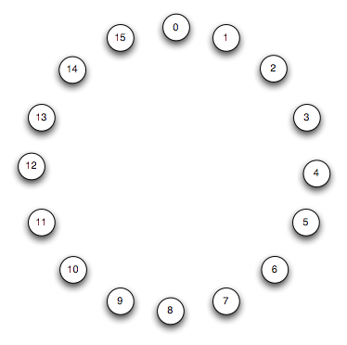
Popular DHT: Chord
(from J. Hellerstein VLDB 04 Tutorial)
Consistent Hash + DHT
Assume n = 2^{m} nodes for a moment
  A “complete” Chord ring
Key c and node ID N are integers given by hashing into 0,..,2⁴ – 1
  4 bits
Every c should be at the first node N ≥ c.
  Modulo 2^{m}

Slide 180
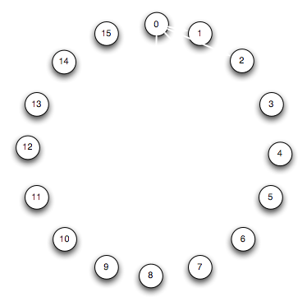
Popular DHT: Chord
Full finger DHT table at node 0
Used for faster search

Slide 181
Popular DHT: Chord
Full finger DHT table at node 0
Used for faster search
Key 3 and Key 7 for instance from node 0

Slide 182
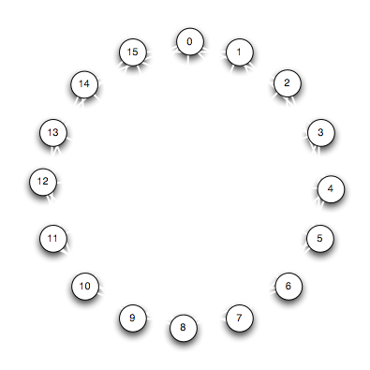
Popular DHT: Chord
Full finger DHT tables at all nodes
O (log n) search cost
  in # of forwarding messages
Compare to LH*
See also P-trees
  VLDB-05 Tutorial by K. Aberer
    In our course doc

Slide 183
Churn in Chord
Node Join in Incomplete Ring
  New Node N’ enters the ring between its (immediate) successor N and (immediate) predecessor
  It gets from N every key c ≤ N
  It sets up its finger table
    With help of neighbors

Slide 184
Churn in Chord
Node Leave
  Inverse to Node Join
To facilitate the process, every node has also the pointer towards predecessor
Compare these operations to LH*
Compare Chord to LH*
High-Availability in Chord
  Good question

Slide 185
DHT : Historical Notice
Invented by Bob Devine
  Published in 93 at FODO
The source almost never cited
The concept also used by S. Gribble
  For Internet scale SDDSs
  In about the same time

Slide 186
DHT : Historical Notice
Most folks incorrectly believe DHTs invented by Chord
  Which did not cite initially neither Devine nor our Sigmod & TODS LH* and RP* papers
  Reason ?
    Ask Chord folks

Slide 187
SDDS & Grid & Clouds…
What is a Grid ?
  Ask J. Foster (Chicago University)
What is a Cloud ?
  Ask MS, IBM…
The World is supposed to benefit from power grids and data grids & clouds & SaaS
Grid has less nodes than cloud ?

Slide 188
SDDS & Grid & Clouds…
Ex. Tempest : 512 super computer grid at MHPCC
Difference between a grid & al and P2P net ?
  Local autonomy ?
  Computational power of servers
  Number of available nodes ?
  Data Availability & Security ?

Slide 189
SDDS & Grid
An SDDS storage is a tool for data grids
  Perhaps easier to apply than to P2P
    Lesser server autonomy
    Better for stored data security

Slide 190
SDDS & Grid
Sample applications we have been looking upon
  Skyserver (J. Gray & Co)
  Virtual Telescope
  Streams of particules (CERN)
  Biocomputing (genes, image analysis…)

Slide 191
Conclusion
Cloud Databases of all kinds appear a future
  SQL, Key Value…
Ram Cloud as support for are especially promising
  Just type “Ram Cloud” into Google
Any DB oriented algorithm that scales poorly or is not designed for scaling is obsolete

Slide 192
Conclusion
A lot is done in the infrastructure
  Advanced Research
    Especially on SDDSs
  But also for the industry
    GFS, Hadoop, Hbase, Hive, Mongo, Voldemort…
    We’ll say more on some of these systems later

Slide 193
Conclusion
SDDS in 2011
Research has demonstrated the initial objectives
Including Jim Gray’s expectance
  Distributed RAM based access can be up to 100 times faster than to a local disk
  Response time may go down, e.g.,
    From 2 hours to 1 min
RAM Clouds are promising

Slide 194
Conclusion
SDDS in 2011
Data collection can be almost arbitrarily large
It can support various types of queries
  Key-based, Range, k-Dim, k-NN…
  Various types of string search (pattern matching)
  SQL
The collection can be k-available
It can be secure
…

Slide 195
Conclusion
SDDS in 2011
Database schemes : SD-SQL Server
48 000 estimated references on Google for
"scalable distributed data structure“

Slide 196
Conclusion
SDDS in 2011
  Several variants of LH* and RP*
  Numerous new schemes:
    SD-Rtree, LH*_{RS}^{P2P}, LH*_{RE}, CTH*, IH, Baton, VBI…
    See ACM Portal for refs
    And Google in general

Slide 197
Conclusion
SDDS in 2011 : new capabilities
Pattern Matching using Algebraic Signatures
  Over Encoded Stored Data in the cloud
  Using non-indexed n-grams
    see VLDB 08
      with R. Mokadem, C. duMouza, Ph. Rigaux, Th. Schwarz

Slide 198
Conclusion
Pattern Matching using Algebraic Signatures
  Typically the fastest exact match string search
    E.g., faster than Boyer-Moore
    Even when there is no parallel search
  Provides client defined cloud data confidentiality
    under the “honest but curious” threat model

Slide 199
Conclusion
SDDS in 2011
Very fast exact match string search over indexed n—grams in a cloud
    Compact index with 1-2 disk accesses per search only
    termed AS-Index
    CIKM 09
      with C. duMouza, Ph. Rigaux, Th. Schwarz

Slide 200
Current Research at Dauphine & al
SD-Rtree
  With CNAM
  Published at ICDE 09
    with C. DuMouza et Ph. Rigaux
  Provides R-tree properties for data in the cloud
    E.g. storage for non-point objects
  Allows for scans (Map/Reduce)

Slide 201
Current Research at Dauphine & al
LH*_{RS}^{P2P}
  Thesis by Y. Hanafi
  Provides at most 1 hop per search
  Best result ever possible for an SDDS
  See: http://video.google.com/videoplay?docid=-7096662377647111009#
  Efficiently manages churn in P2P systems

Slide 202
Current Research at Dauphine & al
LH*_{RE}
  With CSIS, George Mason U., VA
  Patent pending
  Client-side encryption for cloud data with recoverable encryption keys
  Published at IEEE Cloud 2010
    With S. Jajodia & Th. Schwarz

Slide 203
Conclusion
The SDDS domain is ready for the wide industrial use
  For new industrial strength applications
These are likely to appear around the leading new products
  That we outlined or mentioned at least

Slide 204
Credits : Research
LH*RS Rim Moussa (Ph. D. Thesis to defend in Oct. 2004)
SDDS 200X Design & Implementation (CERIA)
    J. Karlson (U. Linkoping, Ph.D. 1st LH* impl., now Google Mountain View)
    F. Bennour (LH* on Windows, Ph. D.);
    A. Wan Diene, (CERIA, U. Dakar: SDDS-2000, RP*, Ph.D).
    Y. Ndiaye (CERIA, U. Dakar: AMOS-SDDS & SD-AMOS, Ph.D.)
    M. Ljungstrom (U. Linkoping, 1st LH*RS impl. Master Th.)
    R. Moussa (CERIA: LH*RS, Ph.D)
    R. Mokadem (CERIA: SDDS-2002, algebraic signatures & their apps, Ph.D, now U. Paul Sabatier, Toulouse)
    B. Hamadi (CERIA: SDDS-2002, updates, Res. Internship)
    See also Ceria Web page at ceria.dauphine.fr
SD SQL Server
  Soror Sahri (CERIA, Ph.D.)

Slide 205
Credits: Funding
  CEE-EGov bus project
  Microsoft Research
  CEE-ICONS project
  IBM Research (Almaden)
  HP Labs (Palo Alto)

Slide 206
END
Thank you for your attention
Witold Litwin
Witold.litwin@dauphine.fr

