Slide 1
Natural Stored and Inherited Relations
Witold Litwin
Dauphine University
Witold.litwin@dauphine.psl.eu
Presentation at EUSPN/ICTH 2021, Leuven, Belgium.

Slide 2
What’s Up ?
Presumably, everyone in this room is familiar with some SQL DBS
A typical scheme of a stored relation (SR), say R, with foreign keys is not only what you were all told it is
I.e., defines SR R only
It defines in fact a natural Stored and Inherited Relation (SIR) R.

Slide 3
What’s Up ?
A typical query formulating as select-project-join one to R, with joins being equijoins over foreign and referenced keys, formulates as select-project one only to SIR R
The logical navigation free (LNF) query to R in popular terms

Slide 4
Is It Important?
LNF queries are substantially less procedural in practice
There is no any additional data definition work for the DBA
An old dream for the relational DBs becomes true

Slide 5
What’s Up
We recall what SIRs are in general
We define natural SIRs
We show how the scheme of a typical SR R with foreign keys implicitly defines also natural SIR R
On a SIR-enabled (relational) DBS

Slide 6
What’s Up
We outline how to make a popular DBS SIR-enabled
We show that this could be simple
We postulate that every major DBS should become SIR-enabled “better sooner than later”.

Slide 7
Present Foundations of RDBs
Relational database (DB) technology is the core for any modern databases:
Client, Web, Cloud, Big Data…
You name it
There are millions of relational DBs around

Slide 8
Stored and Inherited Relation (SIR)
A (relational) DB consists at present from:
Some stored relations (SRs) with stored attributes (SAs) only, also called base tables
One cannot calculate SA values from the DB scheme
Optionally, - also from views
With inherited attributes (IAs) only
IA-values calculate from the view scheme
Basically, calculate only

Slide 9
Stored and Inherited Relation (SIR)
A SIR R is an SR R enlarged with some IAs
Every SR R tuple becomes sub-tuple of exactly one SIR R tuple
SIR R does not have any other tuples
IAs calculate as if they were in view R defining logically the same relation as SIR R
Termed C-view R
IAs in a SIR form an Inheritance Expression (IE)
SR R may be, by default, referred to as R_ in SIR R
As well as in C-view R scheme
[1] Litwin, W. SQL for Stored and Inherited Relations. 21st Intl. Conf. on Enterprise Information Systems, (ICEIS 2019), http://www.iceis.org/?y=2019 , 12p.

Slide 10
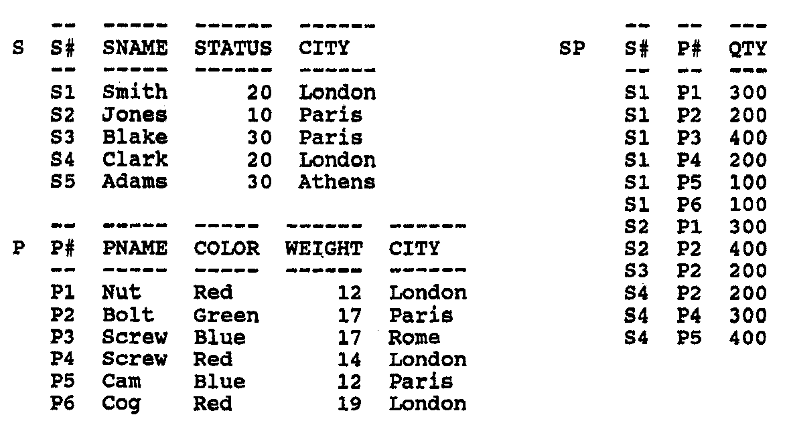
Motivating Example : Codd’s ‘biblical’ S-P DB
S-P1 Scheme
Table S Table P Table SP
S# Char, P# Char, S# Char,
SNAME Char, PNAME Char, P# Char,
STATUS Char, COLOR Char, QTY Int,
CITY Char; WEIGHT Char,

Slide 11
Motivating Example : Codd’s ‘biblical’ S-P DB
S-P1 Scheme
Table S Table P Table SP
S# Char, P# Char, S# Char,
SNAME Char, PNAME Char, P# Char,
STATUS Char, COLOR Char, QTY Int,
CITY Char; WEIGHT Char,
SP.S# and SP.P# are foreign keys
Althougt none is a key of SP
S.S# and P.P# are referenced keys
These are primary keys

Slide 12
Motivating Example : Foreign Keys
Consider e.g., the query Q: select every SNAME, QTY, PNAME where QTY < 300
SQL formulations of Q make sense only because of the foreign keys.

Slide 13
Example
Suppose now S-P.SP SQL scheme as follows:
Create Table SP (S# Char 5, P# Char 5, QTY INT, Primary Key (S#, P#));
One may enlarge it to SIR SP with IE as follows:
Create Table SP (S# Char 5 {SNAME, STATUS, S.CITY} P# Char 5 {PNAME, COLOR, WEIGHT, P.CITY} QTY INT {From SP_ Left Join S On (SP_.S# = S.S#) LEFT JOIN P On (SP_.P# = P.P#)} Primary Key (S#, P#));
SP_ designates by default S-P.SP above
{ } are brackets around parts of the IE
Make SIRs simpler to implement
IE is red and Italic for didactic purpose only

Slide 14
Example
Create Table SP (S# Char 5 {SNAME, STATUS, S.CITY} P# Char 5 {PNAME, COLOR, WEIGHT, P.CITY} QTY INT {From SP_ Left Join S On (SP_.S# = S.S#) LEFT JOIN P On (SP_.P# = P.P#)} Primary Key (S#, P#));
SIR SP is mathematically the same as C-view SP:
Create View SP AS Select SP_.S#, SNAME, STATUS, S.CITY, SP_.P#, PNAME, COLOR, WEIGHT, P.CITY, QTY From SP_ Left Join S On (SP_.S# = S.S#) LEFT JOIN P On SP_.P# = P.P#;
SP_ designates S-P.SP renamed so by default
From now on, S-P1 designates S-P with SIR SP

Slide 15
S-P1 DB with SIR SP IA names and value are Italic
S-P2 Content
Table S Table P
S# SNAME STATUS CITY P# PNAME COLOR WEIGHT CITY
S1 Smith 20 London P1 Nut Red 12 Lon<don
S2 Jones 10 Paris P2 Bolt Green 17 Paris
S3 Blake 30 Paris P3 Screw Blue 17 Oslo
S4 Clark 20 London P4 Screw Red 14 London
S5 Adams 30 Athens P5 Cam Blue 12 Paris
P6 Cog Red 19 London
Table SP
S# SNAMES STATUS S.CITY P# PNAME COLOR WEIGHT P.CITY QTY
S1 Smith 20 London P1 Nut Red 12 London 300
S1 Smith 20 London P2 Bolt Green 17 Paris 200
S1 Smith 20 London P3 Screw Blue 17 Oslo 400
S1 Smith 20 London P4 Screw Red 14 London 200
S1 Smith 20 London P5 Cam Blue 12 Paris 100
S1 Smith 20 London P6 Cog Red 19 London 100
S2 Jones 10 Paris P1 Nut Red 12 London 300
S2 Jones 10 Paris P2 Bolt Green 17 Paris 400
S3 Blake 30 Paris P2 Bolt Green 17 Paris 200
S4 Clark 20 London P2 Bolt Green 17 Paris 200
S4 Clark 20 London P4 Screw Red 14 London 300
S4 Clark 20 London P5 Cam Blue 12 Paris 400

Slide 16
S-P DB with view SP
SP_
View SP
S# SNAMES STATUS S.CITY P# PNAME COLOR WEIGHT P.CITY QTY
S1 Smith 20 London P1 Nut Red 12 London 300
S1 Smith 20 London P2 Bolt Green 17 Paris 200
S1 Smith 20 London P3 Screw Blue 17 Oslo 400
S1 Smith 20 London P4 Screw Red 14 London 200
S1 Smith 20 London P5 Cam Blue 12 Paris 100
S1 Smith 20 London P6 Cog Red 19 London 100
S2 Jones 10 Paris P1 Nut Red 12 London 300
S2 Jones 10 Paris P2 Bolt Green 17 Paris 400
S3 Blake 30 Paris P2 Bolt Green 17 Paris 200
S4 Clark 20 London P2 Bolt Green 17 Paris 200
S4 Clark 20 London P4 Screw Red 14 London 300
S4 Clark 20 London P5 Cam Blue 12 Paris 400

Slide 17
Why View SP for S-P ?
Our query Q to S-P with base tables only, formulates as SQL select-project-join query:
Select SNAME, QTY, PNAME From SP Left Join S On (SP.S# = S.S#) Left Join P On (SP.P# = P.P#) Where QTY < 300;
In red there is the logical navigation (LN) over S, SP and P
Left joins are necessary since, basically, there is no referential integrity in S-P

Slide 18
Why View SP for S-P ?
With view SP used instead of S-P.SP, Q formulates as the LNF SQL select-project:
Select SNAME, QTY, PNAME Where QTY < 300 From SP;
Substantially less procedural formulation
Fewer mandatory characters to type-in

Slide 19
Why SIR SP Instead of view SP ?
Given S-P1.SP instead of view SP in S-P, Q would be:
Select SNAME, QTY, PNAME Where QTY < 300 From SP;
Same thus except that QTY is an SA and SP is a SIR
Who cares ?

Slide 20
Why SIR SP instead of View SP ?
IE in SIR SP is less procedural than view SP
112 mandatory characters instead of 157
Procedurality (so time) gain of almost 30 %
(157 – 112) / 157
Non-procedurality was a driving force for Database Science
For the relational model / Codasyl model in particular
For entire Computer Science, in fact

Slide 21
Can We Do Better ?
How far can we reduce the procedurality of IE for SP scheme ?
Hurray! Typically to ZERO
Create Table SP for SR SP may indeed suffice as an implicit Create Table SP for SIR SP
By inferring from it the explicit Create Table SP for SIR SP
With every IA and From clause

Slide 22
How ?
Every foreign key implicitly inherits as an IA every non-key attribute of the referenced relation
With the same proper name and same value for the same key value
In the nutshell, this usually defines for an SR R with foreign keys its natural SIR R
Our SP is the natural SP (for SR SP and SP_)

Slide 23
How ?
Our implicit natural SIR SP scheme is the one of S-P.SP:
Create Table SP (S# Char 5, P# Char 5, QTY INT, Primary Key (S#, P#));
Our explicit natural SIR SP scheme is the example one:
Create Table SP (S# Char 5 {SNAME, STATUS, S.CITY} P# Char 5 {PNAME, COLOR, WEIGHT, P.CITY} QTY INT {From SP_ Left Join S On (SP_.S# = S.S#) LEFT JOIN P On (SP_.P# = P.P#)} Primary Key (S#, P#));
One can infer IAs from SYSTABLES of any popular DBS
See (easy) rules in the paper

Slide 24
SIR-enabled DBS
SIR-layer manages all SIRs
Internally calls existing (kernel) SQL DBS (not SIR-enabled)
SP defined as presently, canonically becomes internally
Base table SP_ (S#, P#, QTY)
C-view SP formed from {….}
SIR-layer canonically directs every (select) query to C-view SP
Discussed LNF-queries are OK
SIR-enabled DBS
SIR-layer
Kernel
SQL DBS

Slide 25
Conclusion
“Better late than never”, every DBS should become SIR-enabled
Able to manage natural SIRs
LNF queries should become a standard
Queries with LN: – an exception
For advanced clients
Or in bad dream from the past
There are other benefits from SIRs we did not speak about
See the referenced papers

Slide 26
Conclusion
Likely, millions of DBAs, clients developers… should benefit from SIR-enabled relational DBSs

Slide 27
Thanks For
Your Attention
Witold LITWIN
Witold.litwin@dauphine.psl.eu

