Slide 1
Manifesto for Improved Foundations of Relational Model
Witold Litwin
Dauphine University
Witold.litwin@dauphine.psl.eu
Published at EUSPN 2019
Updated for seminar at UCSC-SSRC on March 4, 2020
Updated for Distinguished Speaker Series seminar at IBM-Almaden on March 5, 2020

Slide 2
What’s Up ?
Every normalized relation can be extended with inherited attributes (IAs)
Without getting any new anomalies
Some extended relations can also become:
More faithful to reality
Simpler to query
Queries typically free of logical navigation
Needed for the same queries to the same relations without IAs

Slide 3
What’s Up
All these properties are provided at present only by additional specific views of normalized relations
To add IAs can be nonetheless always less procedural than to define any such views

Slide 4
What’s Up
Present relation schemes with foreign keys should even typically suffice
Through new look at such schemes
As abbreviations of full schemes with IAs we will show how to define
Like for any abbreviations
SSRC, IBM, VIP, MS, SPQR…

Slide 5
What’s Up
Implementing relations with stored and inherited attributes (SIRs) on popular DBSs appears simple.
In fact, it’s already partially done at majors
Foundations of relational model should evolve accordingly

Slide 6
Present Foundations
Relational database (DB) technology is the core for any type of modern databases:
Client, Web, cloud, Big Data…
You name it
There are likely millions of relational DBs around

Slide 7
Present Foundations
However, relational (data) model overlooked a fundamental issue from the beginning
We were all taught that for every normalized relation (table), e.g., in 3rd NF at least, adding an attribute can create a normalization anomaly.

Slide 8
Motivating Example : Codd’s S-P DB
S-P1 Scheme
Table S Table P Table SP
S# Char, P# Char, S# Char,
SNAME Char, PNAME Char, P# Char,
STATUS Char, COLOR Char, QTY Int,
CITY Char; WEIGHT Char,

Slide 9
Imagine SP with SNAME
SP (S#, SNAME, P#, QTY)
With FD S.S# → SNAME determining SNAME for every SP.S#
e.g. for every SP.S1, SNAME is Smith
2nd NF is gone
Normalization anomalies follow

Slide 10
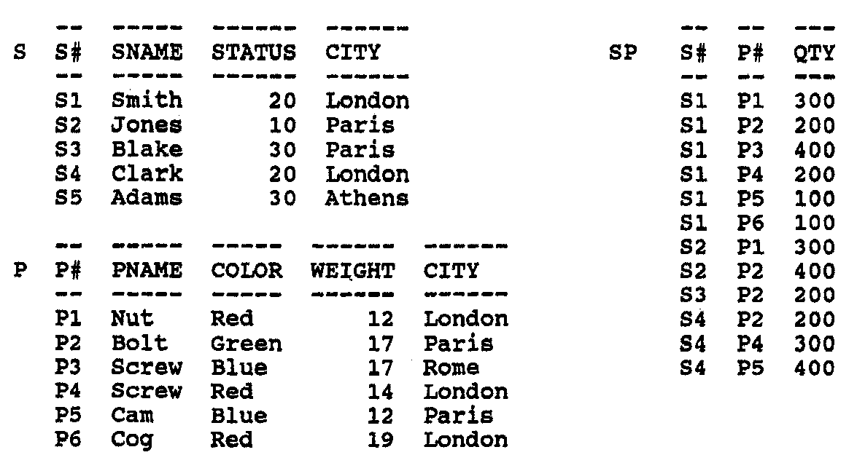
Imagine SP with SNAME
One has to insert Smith 6 times
Instead of once only at present
Saving time & storage
Inserting « Smit » by error for, say, S1,P3 becomes possible
FD S# → SNAME is gone & bad news for queries
Etc.

Slide 11
Present Foundations
Avoid all these drawbacks
Use only normalized relations for DB schemes
That is why S-P DB is as is.
SP especially

Slide 12
Price to Pay
Query: Every part # supplied by ‘Smith’
For SP as present:
Select P# From SP Left Join on SP.S# = S.S# Where SNAME = ‘Smith’
For SP with SNAME:
Select P# From SP Where SNAME = ‘Smith’
No more logical navigation
Buzz around denormalization some years ago

Slide 13
Proposed Foundations
Overlooked implicit assumption
SNAME is a stored attribute (SA)
Base, non-calculable…
This seemed obvious to (about) everyone
For almost 50 years
E.g. see any books about RDBs
Codd’s seminal proposals included

Slide 14
Proposed Foundations
SNAME can be an inherited attribute (IA)
Calculated through a relational or value expression
So to inherit for each SP tuple, SNAME value from S defined by FD we talked about
I.e., for every SP.S#, inherited SNAME would be as S.SNAME for S.S# = SP.S# or would be null if such S.S# did not exists
E.g. for each SP tuple with S# = S1, SNAME value inherited from S would be Smith

Slide 15
Proposed Foundations
Operationally, the expression could be as in specific view we show soon
Defining mathematically the same relation as « denormalized » SP with stored SNAME would be
SP with inherited SNAME would be then mathematically the same relation
But without anomalies

Slide 16
Proposed Foundations
Formally, the result would be a Stored and Inherited Relation (SIR)
E.g. SP (S#, SNAME, P#,QTY)
Italics denote an IA
See [1] for (much) more on SIRs
[1] Litwin, W. SQL for Stored and Inherited Relations. 21st Intl. Conf. on Enterprise Information Systems, (ICEIS 2019), http://www.iceis.org/?y=2019 , 12p.

Slide 17
Example
SQL view being mathematically the same relation as SP (S#, SNAME, P#,QTY) could be:
Create View SP As (Select S#, SNAME, P#, QTY From SP_ Left Join S On (SP_.S# = S.S#)) ;
SP_ is renamed SP (S#, P#,QTY)

Slide 18
Example
Inheritance Expression (IE) defining SNAME in view SP is:
SNAME From SP_ Left Join S On (SP_.S# = S.S#)
Hence SIR SP could be:
(2) Create Table SP (S# Char 5, SNAME, P# Char 5, QTY INT From SP_ Left Join S On (SP_.S# = S.S#) Primary Key (S#, P#));
Here SP_ is the default relation name of all and only SAs in SIR SP
Renamed original SP as well

Slide 19
Example
SP normalization anomalies could similarly concern every other non-key attribute of S or P if in SP
SIR SP should be more general

Slide 20
Example
(3) Create Table SP (S# Char 5, SNAME, STATUS, S.CITY, P# Char 5, PNAME, COLOR, WEIGHT, P.CITY, QTY INT From SP_ Left Join S On (SP_.S# = S.S#) LEFT JOIN P On (SP_.P# = P.P#) Primary Key (S#, P#));
View SP being mathematically the same relation:
(4) Create View SP AS (SP_.S#, SNAME, STATUS, S.CITY, SP_.P#, PNAME, COLOR, WEIGHT, P.CITY, QTY From SP_ Left Join S On (SP_.S# = S.S#) LEFT JOIN P On (SP_.P# = P.P#));

Slide 21
Example
IE in SIR SP is less procedural than view SP
Less mandatory characters to type-in
112 instead of 157
Procedurality (so time) gain of almost 1/3
Non-procedurality was a driving force for Database Science
For the relational model / Codasyl model in particular
For entire Computer Science, in fact

Slide 22
S-P DB with SIR SP (no anomalies)
S-P2 Content
Table S Table P
S# SNAME STATUS CITY P# PNAME COLOR WEIGHT CITY
S1 Smith 20 London P1 Nut Red 12 Lon<don
S2 Jones 10 Paris P2 Bolt Green 17 Paris
S3 Blake 30 Paris P3 Screw Blue 17 Oslo
S4 Clark 20 London P4 Screw Red 14 London
S5 Adams 30 Athens P5 Cam Blue 12 Paris
P6 Cog Red 19 London
Table SP
S# SNAMES STATUS S.CITY P# PNAME COLOR WEIGHT P.CITY QTY
S1 Smith 20 London P1 Nut Red 12 London 300
S1 Smith 20 London P2 Bolt Green 17 Paris 200
S1 Smith 20 London P3 Screw Blue 17 Oslo 400
S1 Smith 20 London P4 Screw Red 14 London 200
S1 Smith 20 London P5 Cam Blue 12 Paris 100
S1 Smith 20 London P6 Cog Red 19 London 100
S2 Jones 10 Paris P1 Nut Red 12 London 300
S2 Jones 10 Paris P2 Bolt Green 17 Paris 400
S3 Blake 30 Paris P2 Bolt Green 17 Paris 200
S4 Clark 20 London P2 Bolt Green 17 Paris 200
S4 Clark 20 London P4 Screw Red 14 London 300
S4 Clark 20 London P5 Cam Blue 12 Paris 400

Slide 23
Codd’s S-P DB with view SP (no anomalies)
SP_
View SP
S# SNAMES STATUS S.CITY P# PNAME COLOR WEIGHT P.CITY QTY
S1 Smith 20 London P1 Nut Red 12 London 300
S1 Smith 20 London P2 Bolt Green 17 Paris 200
S1 Smith 20 London P3 Screw Blue 17 Oslo 400
S1 Smith 20 London P4 Screw Red 14 London 200
S1 Smith 20 London P5 Cam Blue 12 Paris 100
S1 Smith 20 London P6 Cog Red 19 London 100
S2 Jones 10 Paris P1 Nut Red 12 London 300
S2 Jones 10 Paris P2 Bolt Green 17 Paris 400
S3 Blake 30 Paris P2 Bolt Green 17 Paris 200
S4 Clark 20 London P2 Bolt Green 17 Paris 200
S4 Clark 20 London P4 Screw Red 14 London 300
S4 Clark 20 London P5 Cam Blue 12 Paris 400

Slide 24
S-P DB with denormalized SP (full of anomalies)
S-P2 Content
Table S Table P
S# SNAME STATUS CITY P# PNAME COLOR WEIGHT CITY
S1 Smith 20 London P1 Nut Red 12 London
S2 Jones 10 Paris P2 Bolt Green 17 Paris
S3 Blake 30 Paris P3 Screw Blue 17 Oslo
S4 Clark 20 London P4 Screw Red 14 London
S5 Adams 30 Athens P5 Cam Blue 12 Paris
P6 Cog Red 19 London
Table SP
S# SNAMES STATUS S.CITY P# PNAME COLOR WEIGHT P.CITY QTY
S1 Smith 20 London P1 Nut Red 12 London 300
S1 Smith 20 London P2 Bolt Green 17 Paris 200
S1 Smith 20 London P3 Screw Blue 17 Oslo 400
S1 Smith 20 London P4 Screw Red 14 London 200
S1 Smith 20 London P5 Cam Blue 12 Paris 100
S1 Smith 20 London P6 Cog Red 19 London 100
S2 Jones 10 Paris P1 Nut Red 12 London 300
S2 Jones 10 Paris P2 Bolt Green 17 Paris 400
S3 Blake 30 Paris P2 Bolt Green 17 Paris 200
S4 Clark 20 London P2 Bolt Green 17 Paris 200
S4 Clark 20 London P4 Screw Red 14 London 300
S4 Clark 20 London P5 Cam Blue 12 Paris 400

Slide 25
Practical Issue
How far can we reduce the procedurality of IE for SP scheme ?
Hurray! Typically to ZERO
(5) Create Table SP (S# Char 5, P# Char 5, QTY INT Primary Key (S#, P#)); /* Creates the “biblical” SP
May define also SIR SP (3) provided that:
Every foreign key implicitly denotes also all the non-key attributes it references
Stored or, perhaps, themselves inherited
For every foreign key value, the inherited ones are all those for the (same) referenced key value
The outer equijoins are implicit

Slide 26
What is Foreign Key in Fact ?
An attribute referencing a key of a relation
Called then referenced key or relation
Natural foreign key
Same names and same matching values
Referenced key is the primary one
No referential integrity
E.g., SP.S# naturally references S.S#
SP.P# naturally references P.P#
Declared foreign key
A clause defines name and, perhaps value match and referential integrity
On Insert, on update….
E.g., SQL Foreign Key clause

Slide 27
Practical Issue
The explicit result of (5) is SIR SP (3), as stated already, i.e.,:
(3) Create Table SP (S# Char 5, SNAME, STATUS, S.CITY, P# Char 5, PNAME, COLOR, WEIGHT, P.CITY, QTY INT From SP_ Left Join S On (SP_.S# = S.S#) LEFT JOIN P On (SP_.P# = P.P#) Primary Key (S#, P#));
Loosely speaking, we see the traditional Create Table SP (5) as an abbreviation of the actual one (3)
Same for any Create Table with foreign keys

Slide 28
Why New Foundations?
With respect to a base relation, added IAs provide for
More faithful conceptual model
Compare SIR SP and SP_
SP_ is the poorest conceptual model
Hardly real
SP as in (3) is the richest
Most real in other words

Slide 29
Why New Foundations?
Logical navigation free queries
Selects S#, SNAME, P#, PNAME, QTY From SP;
Same result query to SP interpreted as at present:
Selects S#, SNAME, P#, PNAME, QTY From SP_ Left Join S On (SP_.S# = S.S#) LEFT JOIN P On (SP_.P# = P.P#);
Logical navigation doubles the procedurality here

Slide 30
Why Logical Navigation Altogether?
A typical, real-life inspired, query to a relation with a foreign key needs some referenced attributes as well
E.g. A typical Select query to SP needs SNAME or PNAME at least
Cryptic S# or P# alone rarely suffice in real life
As long as these attributes are not with foreign keys, logical navigation is a must

Slide 31
Why New Foundations?
Present practice
Extend S-P with specific view SP
Defining mathematically the same relation as our SIR SP
Our view SP (4) in fact :
(4) Create View SP AS (SP_.S#, SNAME, STATUS, S.CITY, SP_.P#, PNAME, COLOR, WEIGHT, P.CITY, QTY From SP_ Left Join S On (SP_.S# = S.S#) LEFT JOIN P On (SP_.P# = P.P#));
Query view SP instead of base table SP

Slide 32
Why New Foundations?
However, as hinted to, adding IAs to a stored table can be always less procedural than adding equivalent view to the DB
As seen for table SP / view SP
Recall the 112 characters for IE in Create Table SP (3) instead of 157 for Create View SP (4)

Slide 33
Why New Foundations?
As also seen, it can cost even nothing
E.g. our Create Table SP (5) / Create View SP (4)
0 added characters / 157 characters for the view
Same for altering SIR SP / view SP

Slide 34
Implementing SIRs
SIR-layer manages all SIRs
Internally calls existing (kernel) SQL DBS (not SIR-enabled)
SP, even defined as presently by (5), canonically becomes internally
Base SP_ (S#, P#, QTY)
View SP (4)
SIR-layer canonically directs every query to view SP
Discussed logical navigation free queries are OK
Simple ?
SIR-enabled DBS
SIR-layer
Kernel
SQL DBS

Slide 35
Crash Course
You consider the traditional:
SP (S#, P#, QTY)
From now on, you mean:
SP (S#, SNAME, STATUS, S.CITY, P#, PNAME, COLOR, WEIGHT, P.CITY, QTY)
Nothing new, you just transpose a popular idea
USA, EC, VIP, SIGMOD, VLDB, EDBT…
Already known to Romans
E.g., SPQR & next slide

Slide 36
Caseres Art Museum

Slide 37
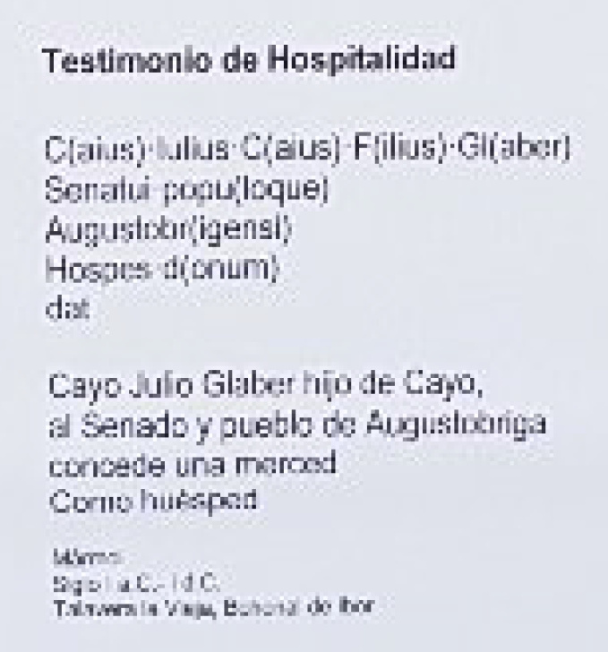
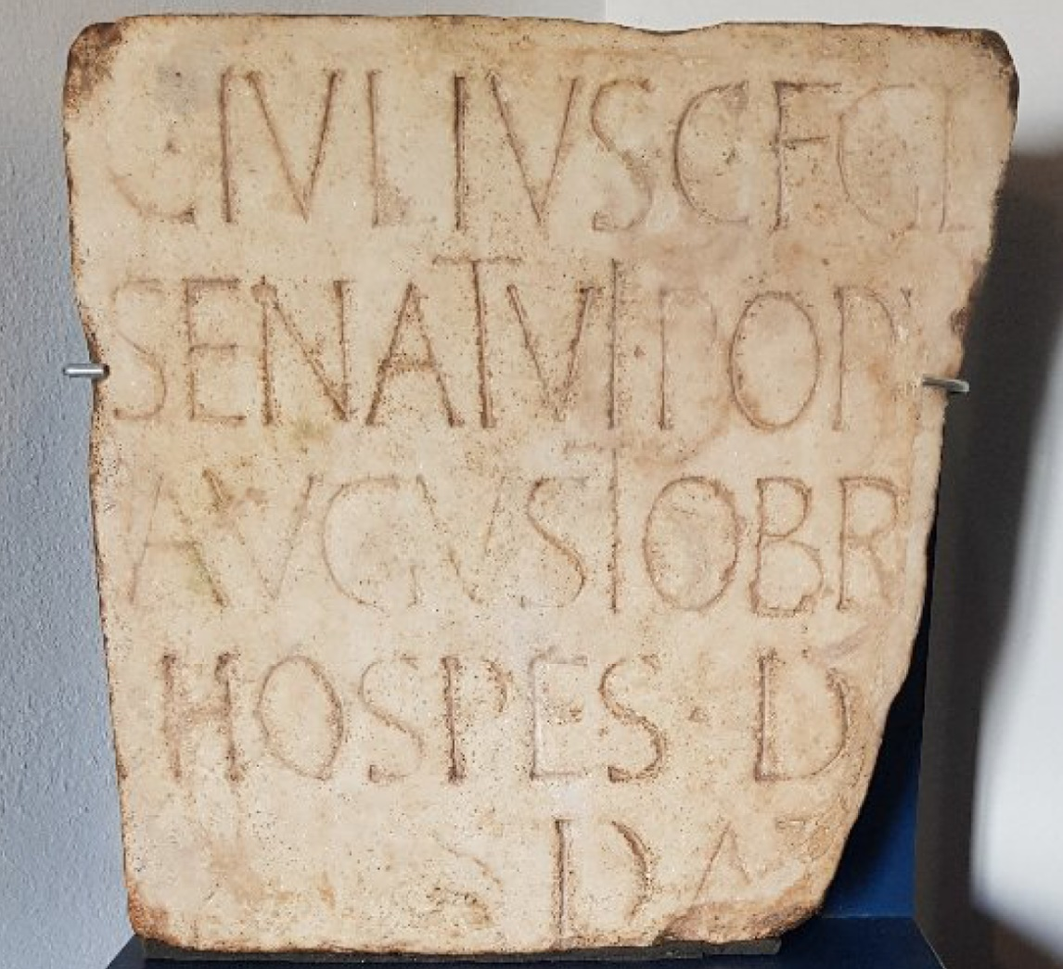
Caseres Art Museum
C, F, Gl, Popu… are Roman « foreign keys »

Slide 38
Crash Course
You write for SIR-enabled SQL DBS:
Create Table SP (S# Char 5, P# Char 5, QTY INT Primary Key (S#, P#));
DBS extends S# and P# :
Create Table SP (S# Char 5, SNAME, STATUS, S.CITY, P# Char 5, PNAME, COLOR, WEIGHT, P.CITY, QTY INT From SP_ Left Join S On (SP_.S# = S.S#) LEFT JOIN P On (SP_.P# = P.P#) Primary Key (S#, P#))

Slide 39
Crash Course
SIR-enabled DBS canonically issues to the kernel SQL DBS:
Create Table SP_ (S# Char 5, P# Char 5, QTY INT Primary Key (S#, P#));
Create View SP AS (SP_.S#, SNAME, STATUS, S.CITY, SP_.P#, PNAME, COLOR, WEIGHT, P.CITY, QTY From SP_ Left Join S On (SP_.S# = S.S#) LEFT JOIN P On (SP_.P# = P.P#));

Slide 40
Crash Course
From now on, SIR-enabled DBS canonically directs every Select query to SP to view SP
Queries to S or P and SP are free of usual logical navigation
Over foreign & references keys
Without DBA defining any views

Slide 41
Crash Course
For update queries: Insert, Update, Delete, SIR-enabled DBS processes those towards view SP or table SP_ or, even, other tables in S-P
According to view update capabilities of kernel DBS
E.g. Some MySQL capabilities lack to SQL-Server
Details in the papers on my Web site

Slide 42
Conclusion
S-P was the mold for about every relational DB.
Our examples and the benefits of the IAs extend accordingly
Can be expected typical.
Every RDBS should be SIR-enabled
1st implementation of SIRs is the next step
Proposed foundations should enter teaching & textbooks
E.g., Statement: « biblical » SP should not be extended with SNAME … is now « fake news »

Slide 43
Conclusion
New foundation should provide for SIRs
Including our interpretation of foreign keys
One should update the definitions of NF
Relatonal DB design rules should get refreshed

Slide 44
Conclusion
“Better late than never”, it should become common knowledge that, unlike today, a normalized relation may:
Still have also its all other conceptual attributes:
SNAME,…, PNAME,…
Provide for logical navigation free queries
Selects S#, SNAME, PNAME, QTY From SP;
Even if the relation scheme is simply as at present
E.g. for SP

Slide 45
Conclusion
Need for the logical navigation through base relations or need for a specific view shielding those
Becomes only a bad dream
Appears retrospectively a mistake
Due to lack of SIRs in the original relational model
Forbidding exploring foreign keys to the full potential of the concept
Common feeling of logical navigation as unnatural in queries appears justified

Slide 46
Conclusion
Likely, millions of DBAs, clients developers… should benefit from SIR-enabled relational DBSs

Slide 47
Thanks For
Your Attention
Witold LITWIN
Witold.litwin@dauphine.fr

