Slide 1
Manifesto for SIR SQL
Witold Litwin
Dauphine University
Witold.litwin@dauphine.psl.eu
Talk for IBM ICIEI 24Alma Verbania, Italie, April 12-14, 2023

Slide 2
What is SIR SQL ?
SQL for base tables that can be Stored & Inherited Relations (SIRs)
Typical benefit:
LNF or CAF queries to base tables considered SIRs
The same output queries to base tables at present require LN or CA specs within
LN specs : cumbersome equijoins on foreign & referenced keys
CAs specs may include also cumbersome aggregate functions or subqueries

Slide 3
What is The Manifesto All About ?
The problem more in depth
Our Solution
Conclusion

Slide 4
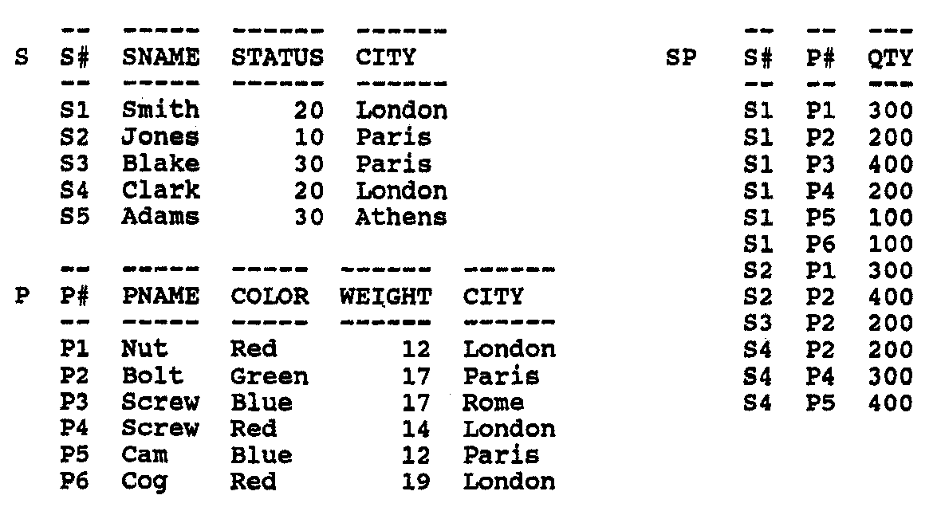
Codd’s ‘biblical’ S-P DB
S-P1 Scheme
Table S Table P Table SP
S# Char, P# Char, S# Char,
SNAME Char, PNAME Char, P# Char,
STATUS Int, COLOR Char, QTY Int,
CITY Char; WEIGHT Int,
CITY Char,

Slide 5
Typical Query to SP By Example
Query that addresses (names) some SP attributes and some S or P attributes
As tables referenced by SP through the foreign keys (FKs) S# and P#
FKs in Codd’s original sense
We call these Primary Key Named FKs (PKN FKs)
E.g. one could wish in SQL for S-P :
Q1 : Select S#, SNAME, P#, PNAME, QTY From SP Where QTY < 200;

Slide 6
Typical Query to SP By Example
It would work if SNAME & PNAME were attributes of SP
But visibly they are not
Normalization anomalies would result
Hence nothing in S-P scheme shows S & P tuples with SNAME and PNAME values matching a selected SP tuple, e.g., (S1, Smith,…) for (S1,P5, 100)
One needs to write at present:
Q2: Select S#, SNAME, P#, PNAME, QTY From SP Left Join S On SP.S#=S.S# Left Join P On SP.P#=P.P# Where QTY < 200;

Slide 7
Typical Query to SP By Example
Q2: Select S#, SNAME, P#, PNAME, QTY From SP Left Join S On SP.S#=S.S# Left Join P On SP.P#=P.P# Where QTY < 200;
In red : the LN
Q2 is more than 2 times procedural than Q1
Outer joins are not a piece of cake for most of SQL clients !
They are necessary for Q2 since there is no referential integrity constraints in S-P

Slide 8
Query with Calculated Attributes (CAs) By Example
SP could indicate the total weight of each supply:
T-WEIGHT = QTY * WEIGHT
One could wish then a CAF & LNF SQL query:
Q3: Select S#,P#,T-WEIGHT From SP;
But SP does not provide for T-WEIGHT
Hence, today, one needs in SQL:
Q4 : Select S#,P#, QTY * WEIGHT As T-WEIGHT From SP Left Join P On SP.P# = P.P#;
In red : CA specs (Including some LN)
Q4 doubles the procedurality of Q3

Slide 9
Our Solution Step By Step
Define SIR Construct For Relational DBs
A 1NF relation, say R, with Stored & Inherited Attributes (SAs & IAs)
IAs are defined as if they were in the canonical view R
IAs cannot lead to normalization anomalies
If SNAME… and PNAME… and T-WEIGHT could be IAs for base table S-P.SP, we could have LNF Q1 and LNF & CAF Q3
And we show they can !
In the paper

Slide 10
Our Solution Step By Step
2. Generalize Create Table & Alter Table to IAs
Possibility of explicit IA names, value expressions & of From clause
Defining the explicit Create Table for a SIR
Interacting with usual SQL table constraints and options
Create Table SP (S#...,P#...,QTY… {SNAME, STATUS, S.CITY, PNAME, COLOR, WEIGHT, P.CITY From SP_ Left Join S On SP.S#=S.S# Left Join P On SP.P#=P.P#} Primary Key (S#, P#));

Slide 11
Our Solution Step By Step
3. Enlarge to SIRs SQL FK concept by merging it with the PKN FK concept.
See the paper for details
See also (masked) slide 22
SP.S# & SP.P# are natural (PKN) FK referencing S & P

Slide 12
Our Solution Step By Step
4. Consider that any PKN FK is a shorthand (also) for all the non-key attributes of the referenced base table with appropriate values
Becoming accordingly the IAs with the same names and values for every FK value = PK value
SP.S# is the shorthand for S.S#, SNAME, STATUS, CITY)
SP.S# = ‘S1’ is the shorthand for (S1, Smith, 20, London)
These IAS become the Natural Inheritance (NI) in SP through S#
See the resulting SP explicit scheme and content on (masked) slide 19

Slide 13
Our Solution Step By Step
5. Provide for (Implicit ) Create Table & Alter Table with NI later inferred from PKN FKs
For our (explicit) Create Table SP above the implicit one would be
Create Table SP(S#..., P#..., QTY… Primary Key (S#, P#));
Same Create Table as would be for SP table at present
From the inception of the relational model, 50+ years ago, we did not look at RDB schemes as we actually should (Codd included)!

Slide 14
Our Solution Step By Step
6. Define rules for Implicit Create Table with IAs not in NI
E.g. T-WEIGHT
Result for SP with T-WEIGHT
Create Table SP (S#...,P#...,QTY {QTY*WEIGHT As T-WEIGHT} Primary Key (S#,P#));
See the paper for the explicit Create Table generated from (similar to Q4 in fact)

Slide 15
Our Solution Step By Step
7. Define the Canonical Implementation of SIR SQL over any existing RDB
SIR-Layer front-end interfacing a popular RDBS
See (masked) slide 20 later on
8. Realize a proof-of-concept prototype
In Python with SQLite as kernel RDBs
3-months of coding work

Slide 16
Conclusion
Since five decades, SQL queries to base tables are unnecessarily procedural, through the presence of LN or CA specs within.
The culprits were
the absence of the SIR construct in Codd’s relational model
the SQL foreign key concept, differing from the original one

Slide 17
Conclusion
Courses and textbooks on relational DBs should start taking notice of SIRs
Every popular SQL DBS should provide for SIR SQL, “better sooner than later”.
The “market size” is apparently
7+ millions of SQL clients,
Including 40% of all developers globally
providing for estimated 31+B US$ market of SQL DBSs, [8].

Slide 18
Thanks For
Your Attention
Witold LITWIN
Witold.litwin@dauphine.psl.eu

Slide 19
S-P1 DB with basic natural SIR SP IA names and value are Italic
S-P2 Content
Table S Table P
S# SNAME STATUS CITY P# PNAME COLOR WEIGHT CITY
S1 Smith 20 London P1 Nut Red 12 Lon<don
S2 Jones 10 Paris P2 Bolt Green 17 Paris
S3 Blake 30 Paris P3 Screw Blue 17 Oslo
S4 Clark 20 London P4 Screw Red 14 London
S5 Adams 30 Athens P5 Cam Blue 12 Paris
P6 Cog Red 19 London
Table SP
S# SNAMES STATUS S.CITY P# PNAME COLOR WEIGHT P.CITY QTY
S1 Smith 20 London P1 Nut Red 12 London 300
S1 Smith 20 London P2 Bolt Green 17 Paris 200
S1 Smith 20 London P3 Screw Blue 17 Oslo 400
S1 Smith 20 London P4 Screw Red 14 London 200
S1 Smith 20 London P5 Cam Blue 12 Paris 100
S1 Smith 20 London P6 Cog Red 19 London 100
S2 Jones 10 Paris P1 Nut Red 12 London 300
S2 Jones 10 Paris P2 Bolt Green 17 Paris 400
S3 Blake 30 Paris P2 Bolt Green 17 Paris 200
S4 Clark 20 London P2 Bolt Green 17 Paris 200
S4 Clark 20 London P4 Screw Red 14 London 300
S4 Clark 20 London P5 Cam Blue 12 Paris 400

Slide 20
Canonical Implementation of SIR SQL
SIR-layer manages all SIRs
Internally calls existing (kernel) SQL DBS (not SIR-enabled, but possibly supporting VAs)
SIR SP defined implicitly as at present, canonically becomes internally (see also (masked) slide 21):
Base table SP_ (S#, P#, QTY)
C-view SP formed from {….}
SIR-layer directs every (select) query to SP
Discussed LNF-queries are OK
Every update query goes to SP_
SIR SQL DBS
SIR-layer
Kernel
SQL DBS

Slide 21
Canonical Implementation of SIR SP
SIR-Layer
Implicit Schema
Create Table SP (S#…, P#...,QTY… Primary Key (S#,P#));
Explicit Schema
Create Table SP (S#…, P#...,QTY…{SNAME…,S.CITY, PNAME…P.CITY From SP_ Left Join On….} Primary Key (S#,P#));
Kernel SQL DBS
Create Table SP_ (S#…, P#...,QTY… Primary Key (S#,P#));
Create View SP (S#, P#, QTY, SNAME…P.CITY From SP_ Left Join On….)
Base Table SP_
C-View SP
S1 P1 300
S1 P2 200
…..
S1 P1 300 Smith ….Nut…. London
S1 P2 200 Smith ….Bolt …. Paris
…..

Slide 22
SIR SQL Foreign Keys
DFK : Declared FK,
i.e., SQL FK
NFK : Natural FK
PKN FK : PK Named FK
RI : Referential Integrity
NI : Natural Inheritance
DFK
NFK
RI
PKN FK
RI & NI
NI

