Slide 1


Adapter les villes aux changements climatiques
Bilan et leçons d'une recherche-action
Florent Joerin
University of applied sciences Western Switzerland
And Laval University
Geneviève Cloutier
Laval University
Notes:
Florent JOERIN
Geneviève CLOUTIER who is postdoctoral fellow at the Graduate School of Planning and Regional Development at Laval University

Slide 2
Plan
Le problème
Une réponse participative
Bilan et discussion
Recommendations
Conclusion
Notes:
The plan of this presentation will have 4 steps. We will introduce our denifition of the problem.
My colleague will then present you the participatory approach that have been applied in Québec-city.
And we will end this presentation with a discussion and some recommendations.

Slide 3
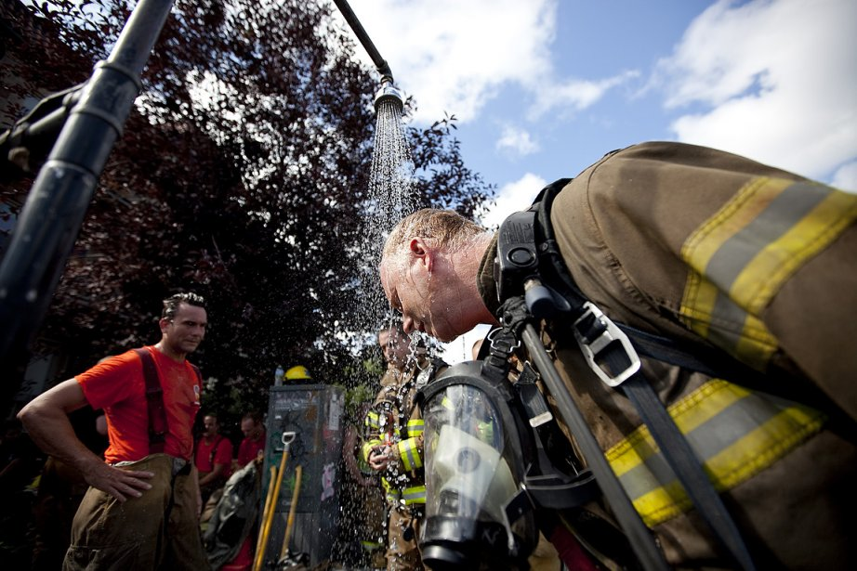
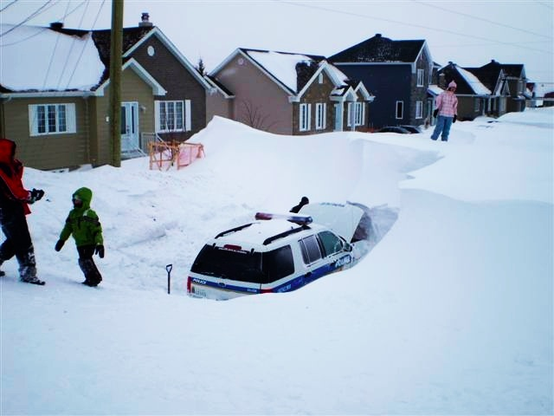
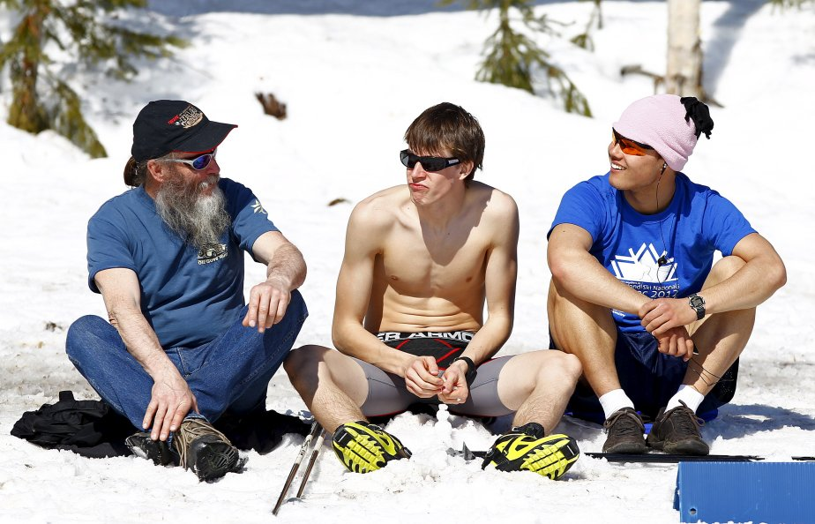
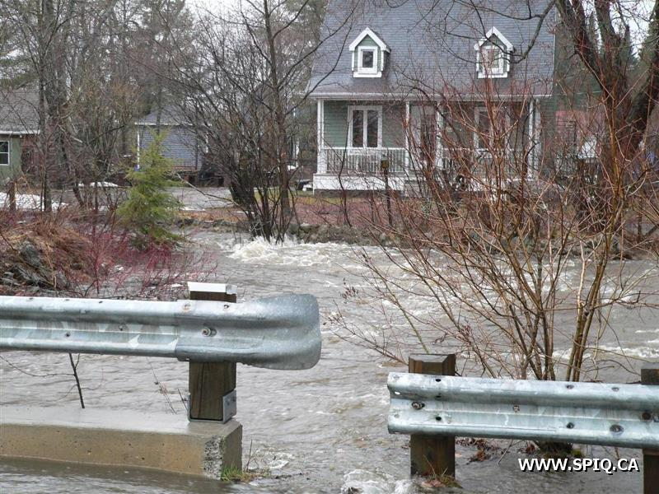
Quel est le problème ?

Slide 4
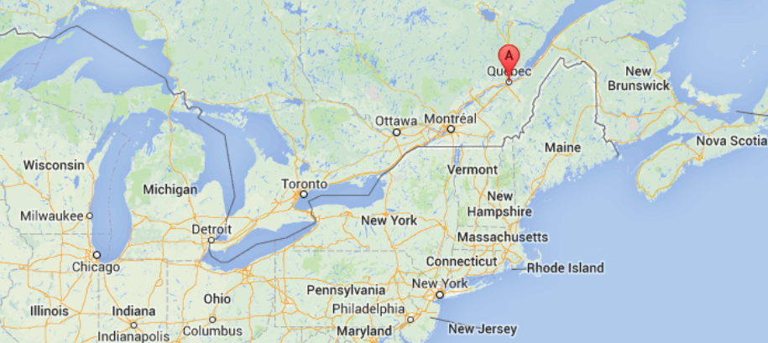
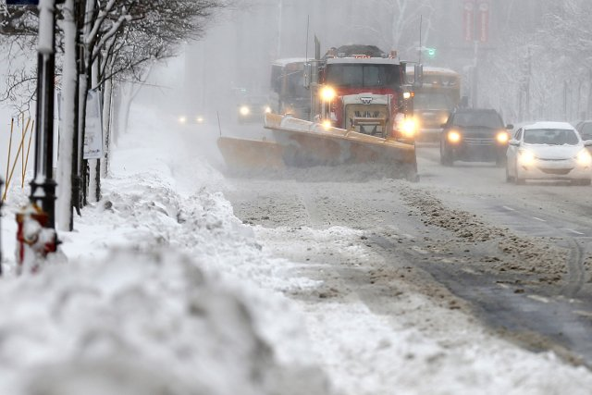
Ville de Québec
Un climat aussi particulier que normal
  Amplitude Tº
    -25°C à +30°C
  Neige
    > 5 m/an en 2010
    De déc. à avril
Mais, une ville adaptée.
Notes:
Quebec city has a very specific climate.
The thermal amplititude is large, between minus 25 in winter and sometimes Thirty degrees in summer.
Quebec city experiences also very snowy winters.
However, even if its climate is very specific, Quebec city has been developped despite the harsch climatic conditions.
And we could say that, in general, Quebec city is nowadays adapted to its climate.

Slide 5
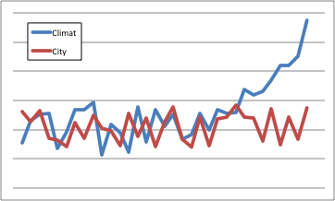
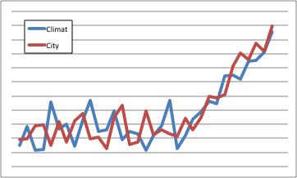
Où est le problème ?
Un risque de divergence
  Le climat change et…
  la ville change.
Comment planifier ou guider le développement urbain vers une adaptation ?
Notes:
So, what is the problem ?
Québec city could meet a problem because this climate and the city are both quickly evolving and there is a risk that these two evolutions could diverge.
In this case, the main question is « How can you plan the city evolution to avoid a possible misadapation ?

Slide 6
Les défis d’une adaptation planifiée
Des avantages
  Une adapation plus économe
  Une adaptation plus équitable
Et des obstacles
  Comment communiquer un désastre qui n’a pas lieu ? Des coûts non dépensés ?
  Manque de données
  Manque de motivation
Notes:
However a planned adaptation presents not only benefits but also obstacles.
The benefits are a lower costs and substantial economies relatively to a reactive adaptation.
Planned adaptation can also improve a social equity in better taking into account the most vulnerable populations.
On the other side, it is quite difficult to communicate about these benefits because they are consisting in an amount of save money or an averted disaster.
It has also to be considered that data are still lacking about the impact of climate change at the urban scale.
Furthemore, stakeholders are still giving a low priority

Slide 7
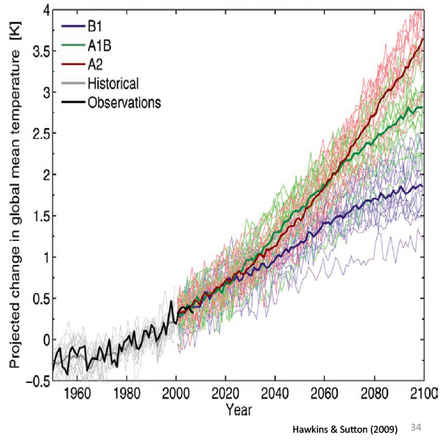
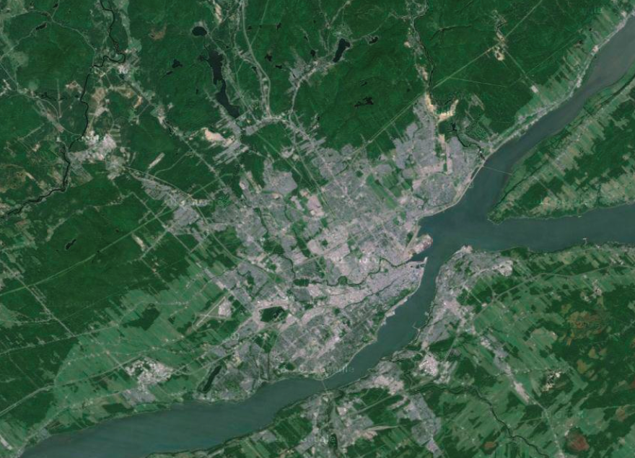
Manque de données
Toujours plus de données
sur le phénomène global
Mais très peu sur les effets locaux
Notes:
A planned adaptation has certainly to face a lack of data.
In deed, there is for sure a great amount of data on climate change, but these data are concerning mainly the climat system itself and research has still produced few information on the impacts of climate change at the urban scale.
This problem can be illustrated by considering that a grid size of fifteen kilometers square is nowadays a high resolution model in regional climatic models. However with this grid size the entire Quebec-city area can be covered with only 4 cells.

Slide 8
Manque de motivation
Urbanisme
Environnement
Qualité urbaine
Transport
Finances, économie
Changement climatique ?
Notes:
Concerning now the relatively low level of priority of planning adaptation to climate change, we have to consider that urban planning is a very complex task.
So adaptation to climate change brings an additional dimension in this complexity and urban planners are naturally presenting a kind of resistance to integrate this extra dimension.

Slide 9
Manque de motivation
Emergence d’un problème
Perception du problèmes
Mise à l’agenda public
Alternatives
Adoption d’un programme
Mise en œuvre plans d’action
Evaluation des effets
Le climat change
Les risques augmentent
Cycle d’une politique publique
Investissement
Formation
Règles
L’adaptation est prioritaire
(Knoepfel, Larrue, Varrone 2006)

Slide 10
Manque de motivation
Il n’y a pas (vraiment) de changement climatique.
Le climat change, mais ce n’est pas un problème.
Le climat change, mais ce n’est pas mon problème.
Le climat change et je peux y faire quelque chose.
Notes:
This low priority can also result from a lack of awareness.
In a theoretical approach, we propose to consider a four levels scale of awareness.
In the fist level can be placed someone who do not believe in climate change.
The second level concerns a person who believe in climate change but do not consider that it is a problem for him or for us.
In the third level, you can find a person who do believe that climate change is a problem, but do not think that this problem is his own problem. In his point of view it is a someone else problem.
At the last level, woud be placed a stakeholder who is considering climate change in his own decisions and actions.
Obviously, stakeholders are to be in this last level to be able to plan adaptation measures to climate change.

Slide 11
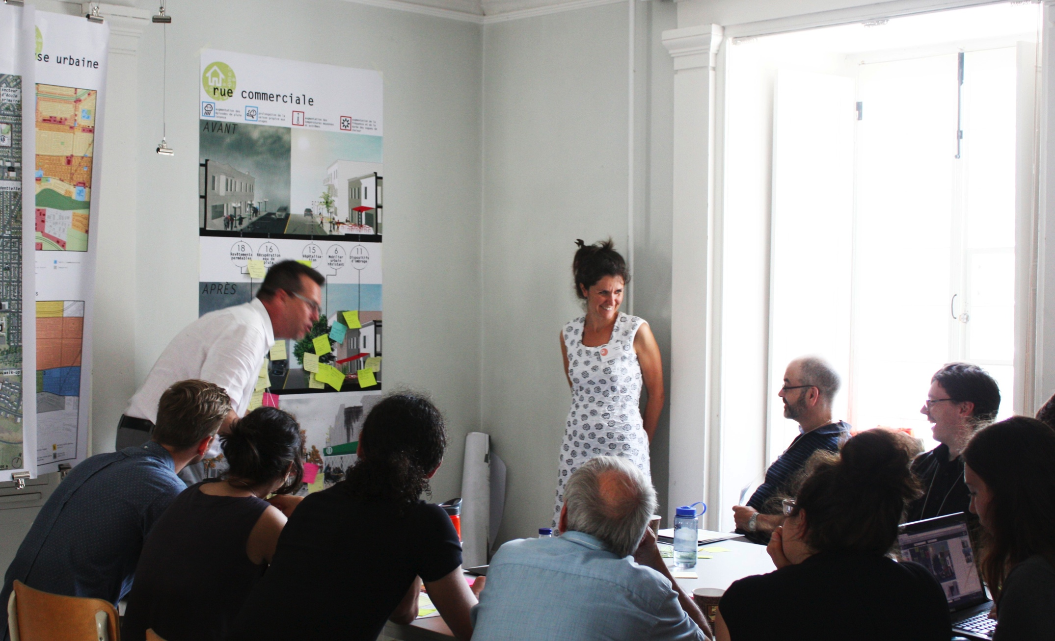
La réponse participative

Slide 12
Application à Québec
Objectifs
  Combler le manque de données
    Expériences d’experts et non-experts
  Renforcer la prise de conscience
    Construire ensemble le problème
  Faciliter la mise en oeuvre
  Anticiper les résistances sociales et institutionelles

Slide 13
Construire un problème
Perspective constructiviste
(A note on the concept of Problem, Landry 1995)
  Les problèmes ne sont ni donnés, ni créés,
  ils sont retenus par le sujet.
  Le problème émerge par l’interaction avec l’objet.
  Pour s’adapter, le sujet produit des connaissances.
  Pour connaître l’objet, il (inter)agit (avec) sur l’objet.
connaissance
Objet
Sujet

Slide 14
Une approche en 3 phases
Quoi ?
Quels sont les principaux impacts des changements climatiques ?
Diagnostic
urbain
Où?
Où agir d’abord ?
Evaluation
des risques
Comment ?
Comment adapter les formes urbaines et architecturales ?
Mesures d’adaptation

Slide 15
Les résultats attendus
Diagnostic urbain
Evènements climatiques
Conséquences territoriales
Risques majeurs
Evaluation des risques
Cartes de risque
Secteurs prioritaires
Mesures d’adaptation
Interventions urbaines ou architecturales

Slide 16
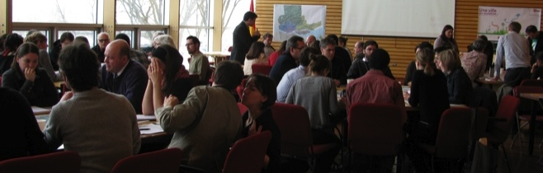
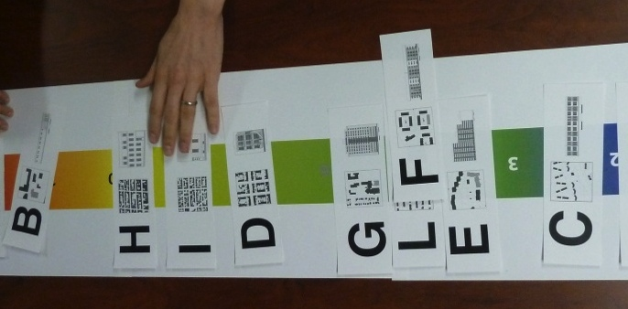

Dispositifs participatifs et outils
  Ateliers / Forum
  Modèles systémiques
Diagnostic
urbain
  SIG et analyse multicritère
  Ateliers d’experts
Evaluation
des risques
  Urban design studio
  Ateliers
  Crowdsourcing
Mesures d’adaptation
Design of Adaptation

Slide 17
Evènements participatifs
Phase | ♯ | Evénement | Type de participants | ♯ de participants | Total
1. Diagnostic urbain | 6 | Groupes de discussion | Acteurs locaux | 8 | 48
 | 1 | Forum | Acteurs locaux | 50 | 50
 | 2 | Projets | Etudiants | 5 | 10
2. Evaluation des risques | 6 | Ateliers multicritères | Experts locaux | 6 | 36
3. Mesures d’adaptation | 1 | Urban design studio | Etudiants | 35 | 35
 | 1 | Crowdsourcing | Acteurs locaux | 36 | 36
 | 1 | Atelier de validation | Acteurs locaux | 23 | 23
All | 18 | Cours-Atelier | Etudiants | 1 | 18
Total |  |  |  |  | 256

Slide 18
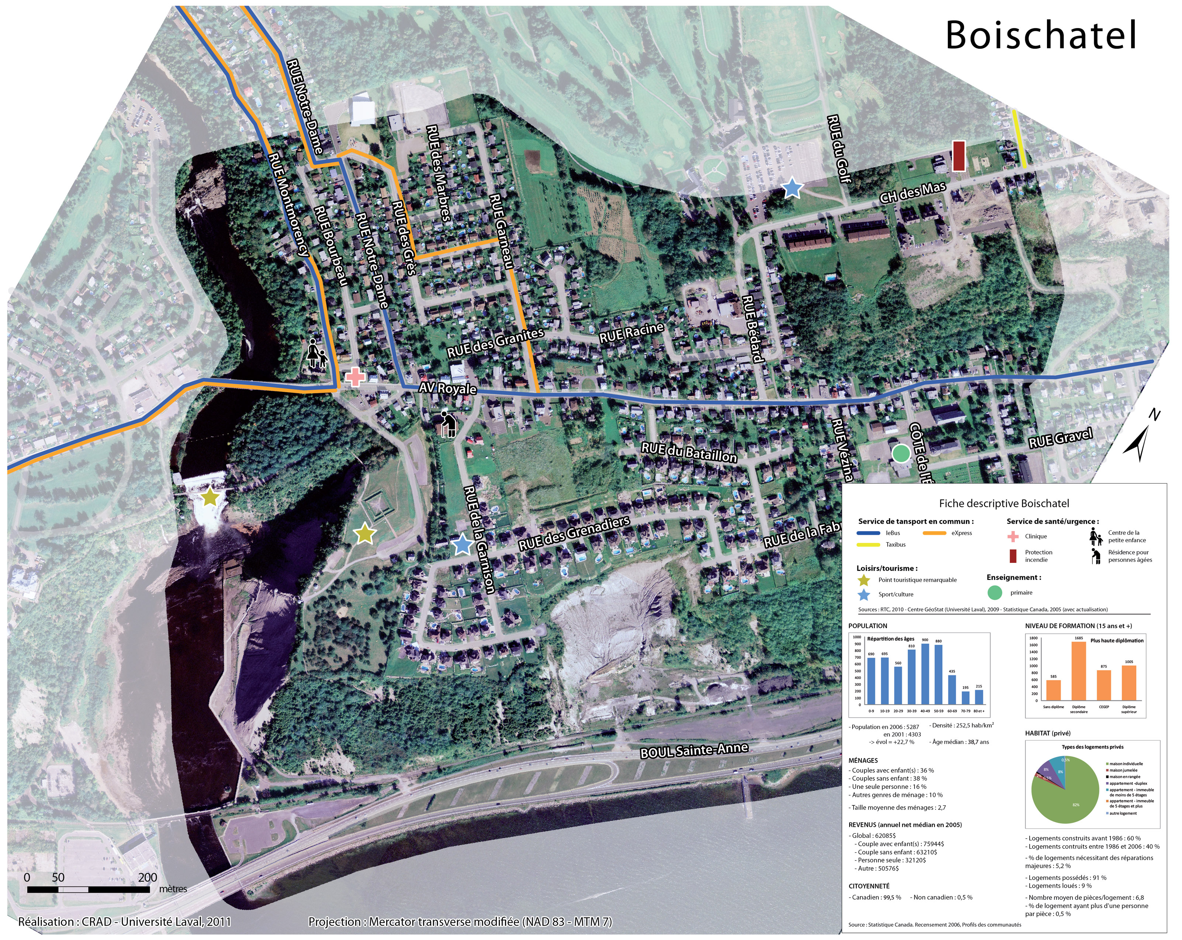
1. Diagnostic urbain : construire le problème
Par l’interaction
Augmentation des précipitation de neiges

Slide 19
Diagnostic urbain : exemple de résultats
Danger
Vulnérabilité
Source d’eau
Eau potable
Diagnostic urbain
Ruissellement
Pollution
microbiologique
Contamination
Pluie extrême
Débordement
Population
Evaluation
Réseau
eau usée
Réseau
eau potable
Adaptation
… affecte..
: évènement
… génère…
: entité
Notes:
In the first year, we have produced systemic models presenting a chain of consequences generate by a climat event.
In this example, the climate event is a heavy rainfall. It has for consequence a microbiological pollution and finally the contamination of part of the population.

Slide 20
Diagnostic urbain : résultat
4 Conséquences principales
 | Transport | Ilôt de chaleur | Eau potable
 | Dommages aux infrastructures | Diminution de la santé | Diminution de la qualité de l’eau (microb.) | Diminution de la quantité d’eau
Sécheresse extrême |  |  | F | I
Pluie extrême | A |  | G | J
Cycles gel-dégel | B |  | H | K
Augmentation générale des pluies | C
Vague de chaleur | D | E
5 Evènements climatiques majeurs
11 Situations principales de risque (A-K) pouvant se produire à Québec
Notes:
So, in synthesis, the firs step has allowed to define in the context of Quebec city, 5 Main climate events that could produce 4 main type of consequences.
Combining theses climates events with the selected consequences, 11 situations of risk have been considered.
It is important to precise that this a simplification had to be made considering the project duration and the available competences in the research team.
In other words, some others climate events, consequences or risk could have been considered if more ressources were available.

Slide 21
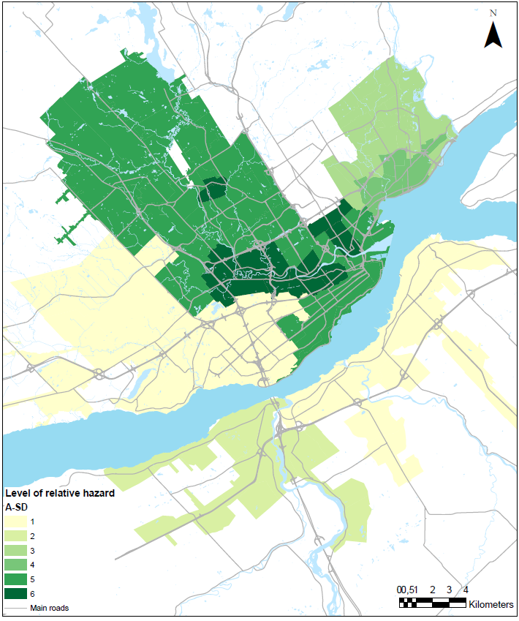
Evaluation des risques: exemple de résultats
Carte de danger
Diagnostic
Evaluation
des risques
Adaptation
Diminution de la quantité d’eau potable en situation de sécheresse extrême (I) .
Notes:
During the second year, the risk assesment results in the production of maps presenting different levels of risk on the study area.
This map concerns the risk of potential decrease in availability of drinking water at the consumer’s tap in severe dought.

Slide 22
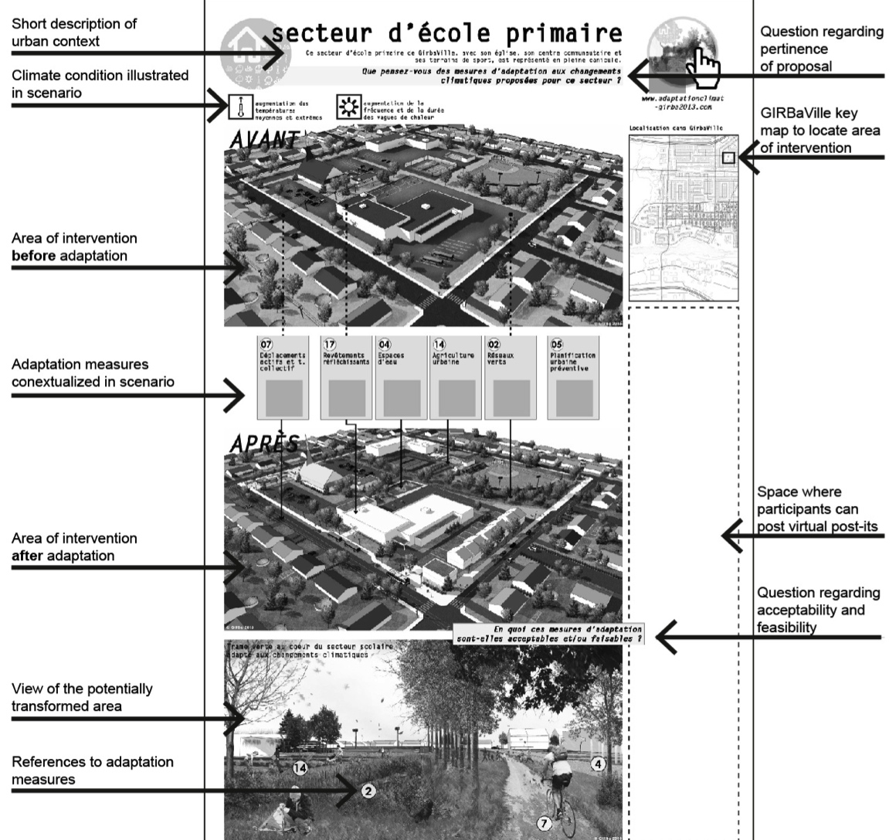
Mesures d’adaptation:
exemple de résultats
Exemple de scénario d’adaptation soumis
à validation lors de l’atelier de juillet 2013.
Diagnostic
Evaluation
Mesures d’adaptation

Slide 23
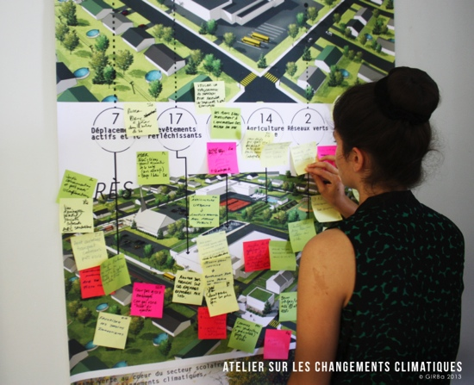
Quel Bilan de l’expérience ?
Notes:
Having now described the approach applied in Québec-city in order to support a planned adaptation to climate change, we can abord the last part of this presentation which is a discussion about its successes or failures.

Slide 24
Phase par phase
 | Diagnostic urbain | 2. Evaluation des risques | 3. Mesures d’adaptation | Global
Niveau de participation
Qualité du résultat
Outils et méthodes
Atelier multicritère
Transport
Atelier multicritère
Eau potable
Atelier multicritère
Ilot de chaleur
Notes:
A complete and rigourous evaluation of the approach has still to be made. However, in general terms, we are able to assess, globally and for each different steps, if we have reached our objectives.
So as you can see with this simple table, we are considering that the approach has been in generla very satisfying.
However, our appreciation is little less positive in the second step,the risk assessment step.

Slide 25
Evaluation des risques
 | Transport | Ilot de chaleur | Eau potable
Niveau de participation
Qualité du résultat
Outil multicritère | Electre | DRSA | DRSA
Almeida-Dias, J., Figueira, J. R., & Roy, B. (2010). Electre Tri-C: A multiple criteria sorting method based on characteristic reference actions. European Journal of Operational Research, 204(3), 565-580.
Greco S., Matarazzo B., Słowiński R., 2001, « Roughset theory for multicriteria decision analysis », European Journal of Operational Research, 129 (1), pp. 1–47
Notes:
As already mentionned we have organised in this step a set of workshops, called multicriteria workshops, with different experts of the considered domains.
The general goal of these workshops was to fix the parameters of multicriteria analysis allowing to rank the different sectors of the city considering a scale of risk level.
These workshops hves been realised in the following order : transport, heat island and then drinking water.
Reading this table you can observe that if the first one, concerning Transport, has met many problems, the last one, about drinking water has been more successful.
This improvement is partially due to the fact that we have chosen to use the DRSA (Dominance base rought set analysis) multicriteria analysis tool after facing some difficulties with the Electre Tri approach we have applied in the first workshop concerning Transport.
However despite of this improvement, none of these workshops has allowed to produce the results we were looking for.

Slide 26
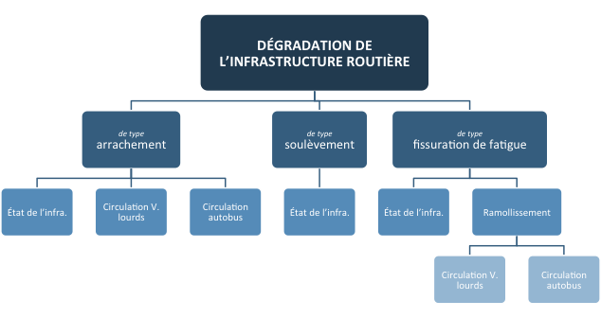
Atelier multicritère - Transport
Méthode
  Structure hiérarchique
  Elicitation directe avec Electre – Tri
Problèmes rencontrés
  -> Inadapté pour obtenir des appréciations
  basées sur l’expertise
-> Aucun résultat
Almeida-Dias, J., Figueira, J. R., & Roy, B. (2010). Electre Tri-C: A multiple criteria sorting method based on characteristic reference actions. European Journal of Operational Research, 204(3), 565-580.
Notes:
Let’s see now what could be the explanation of these difficulties in the multicriteria workshops.
Concerning workshops on Transportation, we have applied in this case an approach base on direct elicitation.
So the experts were asked to directly s etthe multicriteria parameters used in Electre Tri, which are, for example, the multicriteria weights and thresholds.
In our point of view the direct elicitation was difficult for the experts because it invites them to stay in traditionnal scientific approach. So when we ask them to set weight, they refuse to give an answer without addiitional scientific data or studies. They wanted to go back to their office in order to make some computions or litterature review. Unfortunatelity, it was not possible, we did not have the time to make a particular study to set each parameters . It would be a huge and unnecessary amount of work.
In brief our point of view, based on this experiment would be that direct elicitation is in fact unadapted to get rough appreciation based on expertise and experiences.

Slide 27
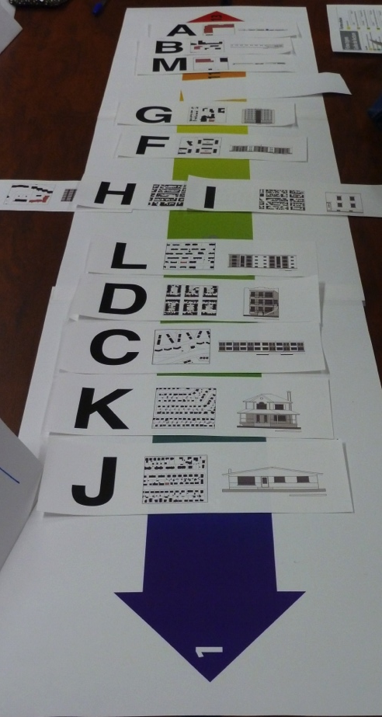
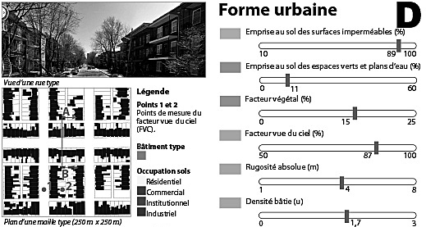
Atelier multicritère
Ilôts de chaleur
Méthode
  Appréciation globale
  Inférrence avec DRSA
    Basé sur des exemples
    Fondées sur l’expérience
Problèmes rencontrés
  Incompréhension théorique
    le batiment, son environnement
    et l’ilot de chaleur.
- > Résultats inutilisables
Greco S., Matarazzo B., Słowiński R., 2001, « Roughset theory for multicriteria decision analysis », European Journal of Operational Research, 129 (1), pp. 1–47
Notes:
In the second set of multicriteria workshop, concerning Heat island, we applied indirect elicitation, using as already said the DRSA multicriteria analysis method.
In this approach for elicitation, experts are asked to rank a set of examples, made of almost real urban contexts, on a scale ranging from low to high level of risk.
This approach appears to be more effective in order to get answer based on personal and professionnal expertise and knowledge.
However, we still face a problem beacause, we observe a certain miscomprehension in the experts answers about the interaction between buiding-neighborhood and heat wave.
This miscomprehension has been confirmed when the result of the multicriteria analysis has been compared with a set of measures data.

Slide 28
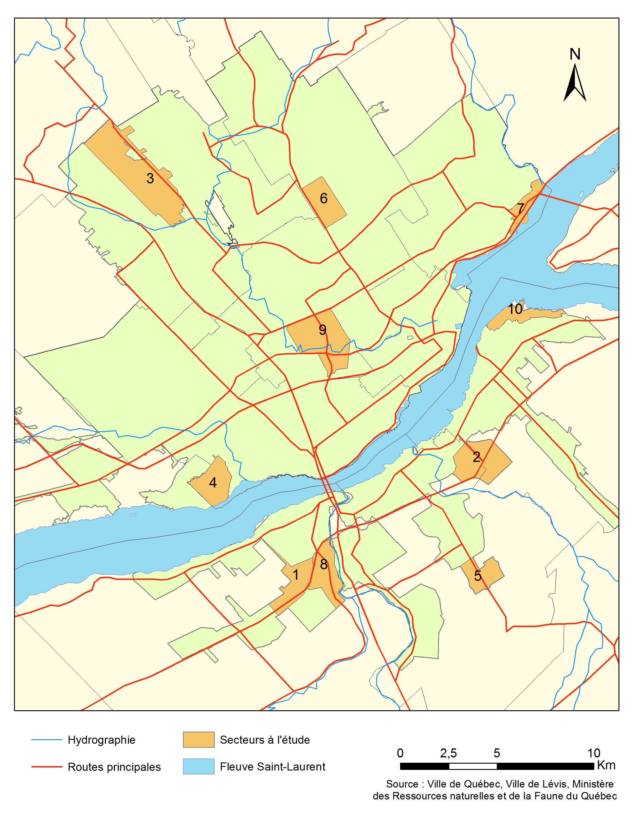

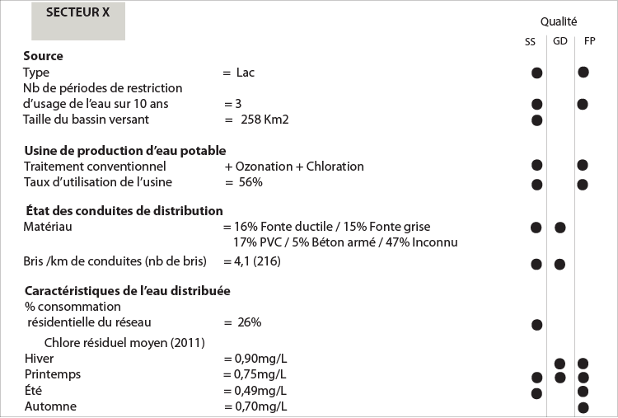
Atelier multicritère – Eau potable
Méthode
  Appréciation globale
  Inférrence avec DRSA
    Basé sur des exemples
    Fondées sur l’expérience
Problème rencontré
  Echelle et données trop générales
    Différentiation insuffisante
> Résultats peu utiles
Notes:
In the last set of multicriteria workshops concerning , we have also applied indirect elicitation.
Like for heat wave, we note that this approach helps the experts to give answers based on their professionnal experiences.
Furthermore, we observe that experts of this domain did have a good comprehension of how climat change could impact the drinking water system.
Unfortunately, if the results of the multicriteria analysis seemed to be of good quality, we faced this time a scale problem.
In fact the available data about the drinking water system were too general and unprecise to allow to make real distinctions inside the different city networks.
For this reasons, results obtained about the drinking water were not really useful.

Slide 29
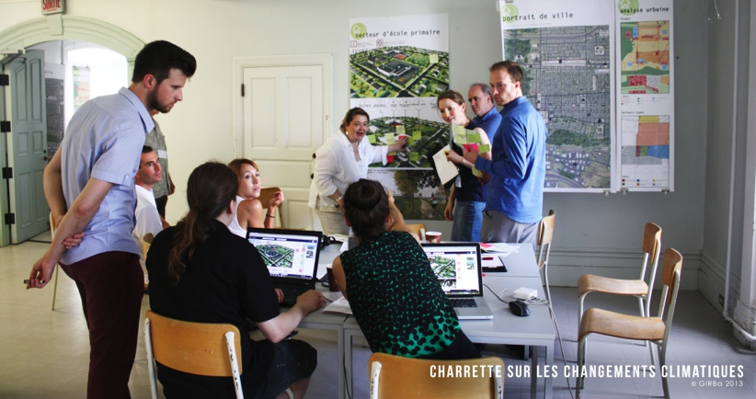
Comment mieux faire ?
Notes:
We have seen in the previous part of this presentation that even the general approach applied in this project has produced many sucesses it has also sometimes failed.
So the question we are trying now to answer is :

Slide 30
Deux recommendations
Type de données sollicitées dans le processus décisionnel
L’échelle spatiale
Notes:
We are so proposing two recommendations. The first one concerning the type of informatin to be used.
The second one the spatial scale.

Slide 31
Quel type d’information ?
 | Données informelle | Données formelles (traditionnelle)
Source | Appréciations d’experts basées sur l’expérience | Base de données institutionnelles Etudes scientifiques
Qualité | Inconnue | Validée (scientifique ou procédure)
Disponibilité | Disponible mais rarement utilisée | Croissante mais encore incomplète Lente à acquérir
Notes:
In order to precise our recommendation about the type of information to be used, I would like first to make a difference between what we call : informal and formal data.

Slide 32
Quel type d’information ?
Phase | Données informelles | Données formelles
Diagnostic urbain | Principale | Secondaire
2. Evaluation des risques | Secondaire | Principale
3. Mesures d’adaptation | Croisée et interactive
L’évaluation du risque n’est ni tout à fait objective,
ni tout à fait subjective, mais une construction sociale et contextuelle.
Phase | Données informelles | Données formelles
Diagnostic urbain | Principale | Secondaire
2. Evaluation des risques | Croisée et interactive
3. Mesures d’adaptation | Croisée et interactive
Notes:
So, in the applied approach for Québec-city
And we have met some difficulties in the second step because formal data were not sufficient and it has been difficult to produde good results based on informal data.
So our recommendation is to also apply in the riks asssment a shared and iterative approach mixing formal and informal data.
This modification is quite significant, because it involves to consider that risk assessment is ...

Slide 33
Echelle spatiale
Phase | Echelle | Principaux résultats
Diagnostic urbain | Ville | Evènements climatiques majeurs et conséquences
2. Evaluation des risques | Ville | Cartes de risque et secteurs prioritaires
3. Mesures d’adaptation | Quartier | Mesures d’adaptation
A chaque étape, pour chaque échelle, il s’agit d’utiliser au mieux l’ensemble des données dans une approche croisée et interactive.
La ville
Diagnostic urbain
2. Evaluation des risques
3. Mesures d’adaptation
L’arrondissement
Diagnostic urbain
2. Evaluation des risques
3. Mesures d’adaptation
Le quartier
Diagnostic urbain
2. Evaluation des risques
3. Mesures d’adaptation
Notes:
Concerning the spatial scale, in the applied approach, the first step and second step has been treated at the scale of the entire city, and only the third step was at the neighborhood scale.
This change of scale has been realised by the definition of priority sectors at the end of the second step.
So, our recommendation about the spatial scale would be to realise the three steps at each different spatial scale, and also to consider an intermediate scale (a district scale) between the entire city and the neighborhood.
If this approach is applied, at each scale and for each step, would be used the best available (between informal and formal data) in a shared and iterative approach.

Slide 34
Conclusion
Ce projet a permis d’initier et accompagner un processus d’adaptation au changement climatique
  Renforcer une prise de conscience des conséquences.
  Proposer un ensemble de mesures socialement et techniquement validées.
L’utilisation de données informelles semble efficace et indispensable.
Notes:
In conclusion,
This project also demonstrates that informal data can be usefully used in particular during the urban diagnosis.
The use of informal data is in our point of view « indispensable » in order to plan, in time, adaptation to climate change

Slide 35
Conclusion
Prochains défis
  Intégrer l’évaluation des risques dans la définition des secteurs prioritaires.
    Efficacité des ateliers multicritères
  Utilisation combinée d’information formelle et informelle dans l’évaluation des risques
  Mieux considérer la dimension scalaire du processus.
Notes:
However, this project has also put the light on new challengesthat still has to be faced in order to apply a real strategic decision process in the planning of adaptation measures to climate change.

Slide 36

Merci de votre attention !
Notes:
Thank you for your attention

